Slide 1


Exposure CS 2021
for CS1
Chapter 7 Section 6-10 Slides
2-Way, Multi-Way & Nested Selection
and Formatting Numerical Output
PowerPoint Presentation
created by:
Mr. John L. M. Schram
and Mr. Leon Schram
Authors of Exposure
Computer Science

Slide 2


Section 7.6
Two Way
Selection

Slide 3
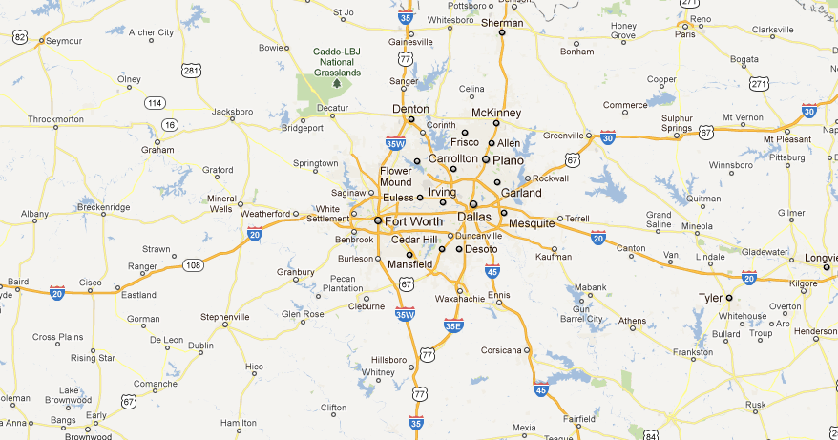
Two-Way Selection Real Life Example
I35W takes you to Fort Worth.
I35E takes you to Dallas.
Interstate 35 splits into I35W and I35E just North of Hillsboro.

Slide 4
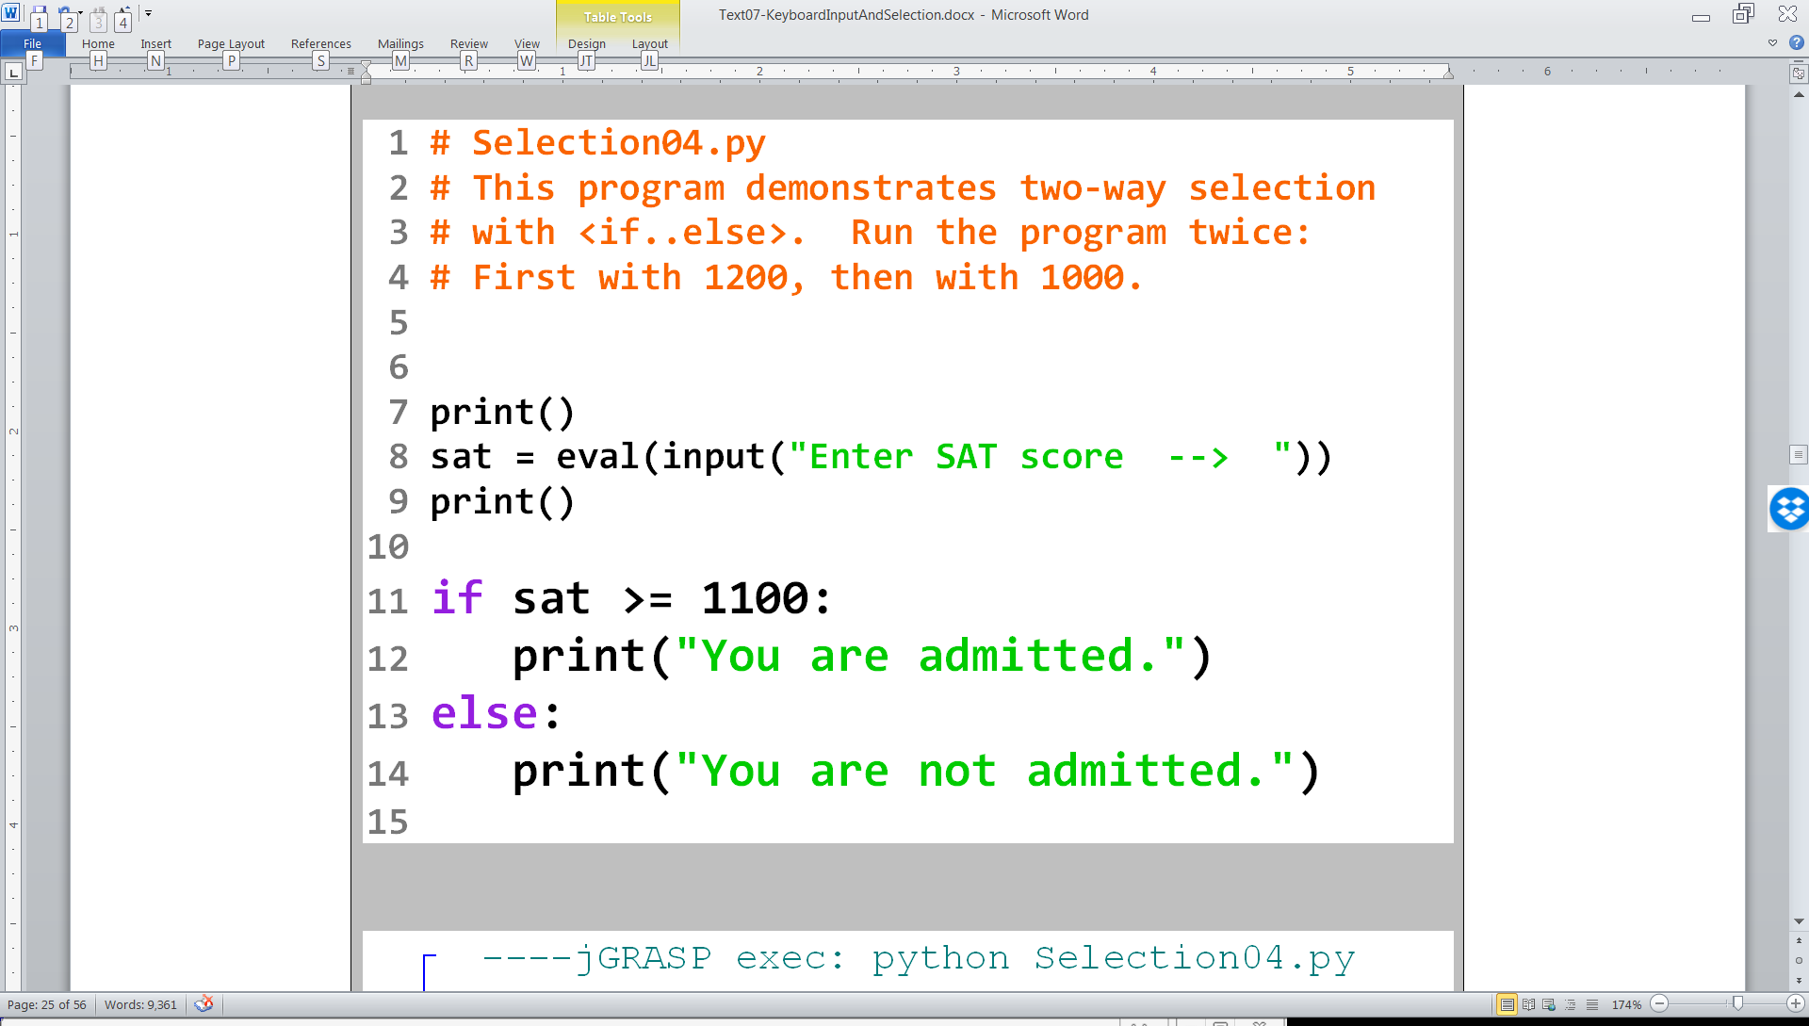

Slide 5
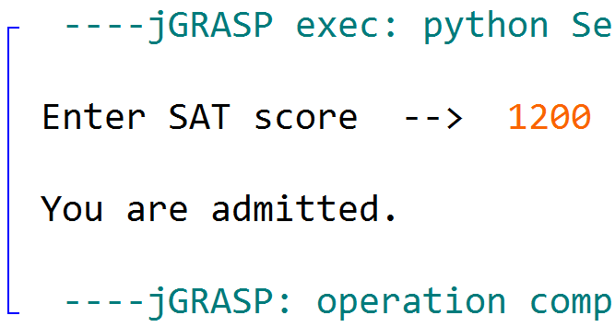

Slide 6
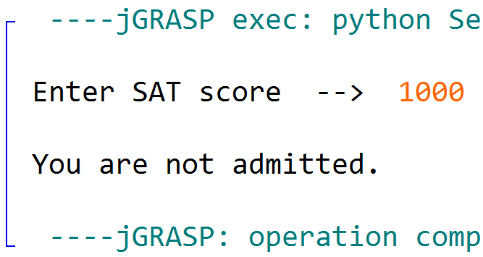

Slide 7
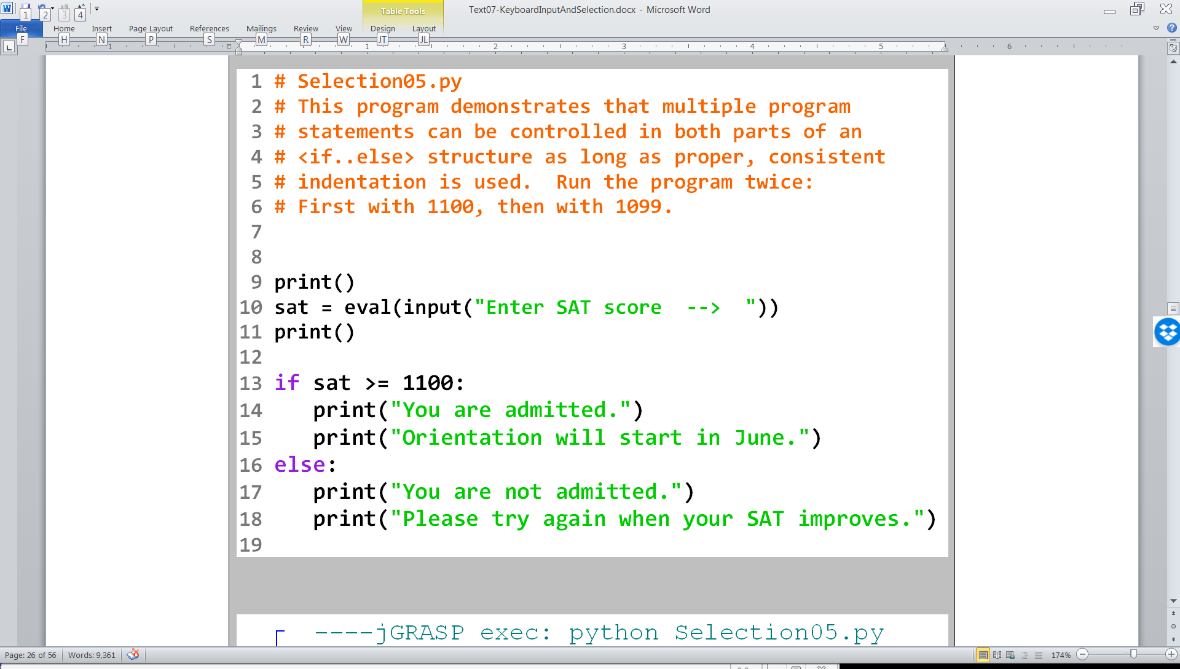

Slide 8
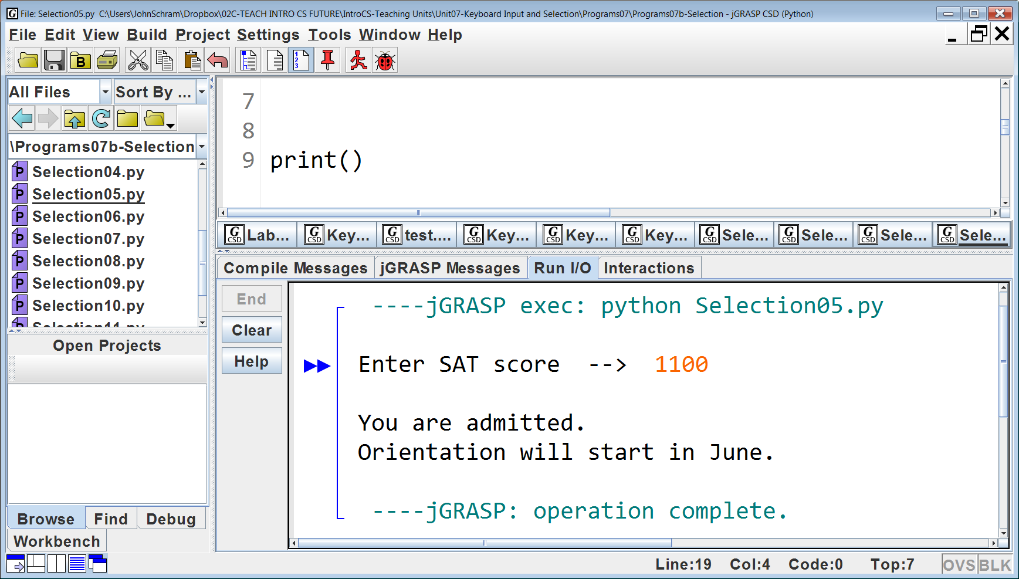
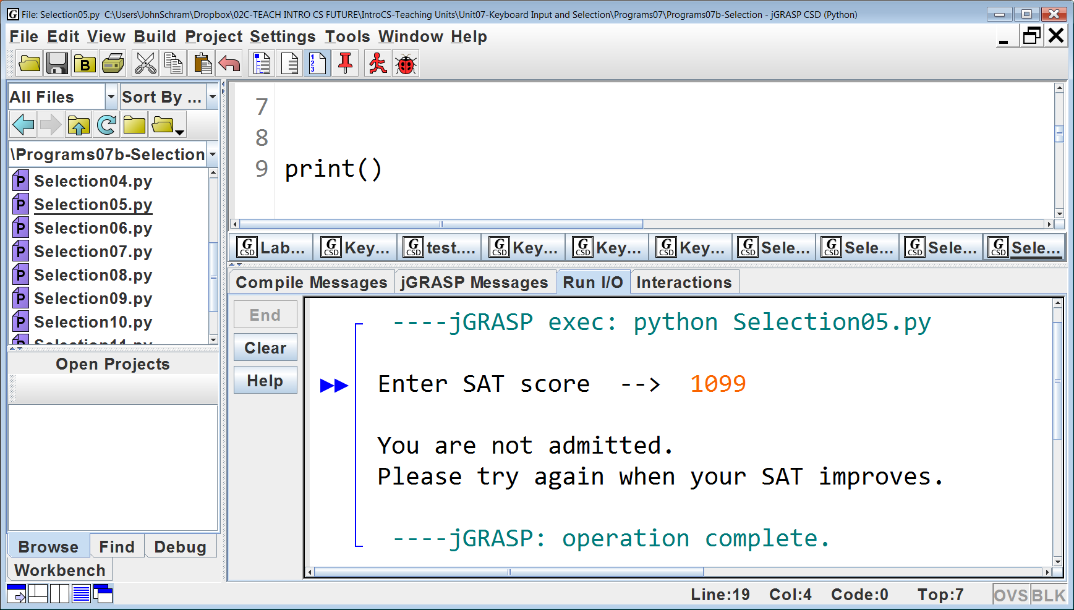

Slide 9
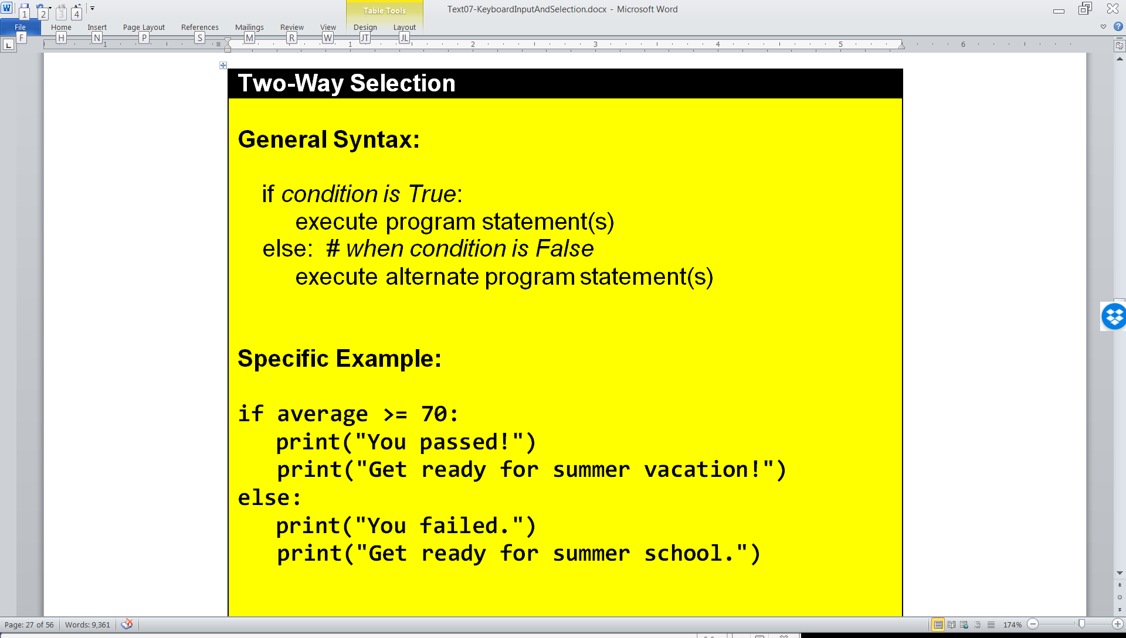

Two-Way Selection

Slide 10

Section 7.7
Multi-Way
Selection

Slide 11
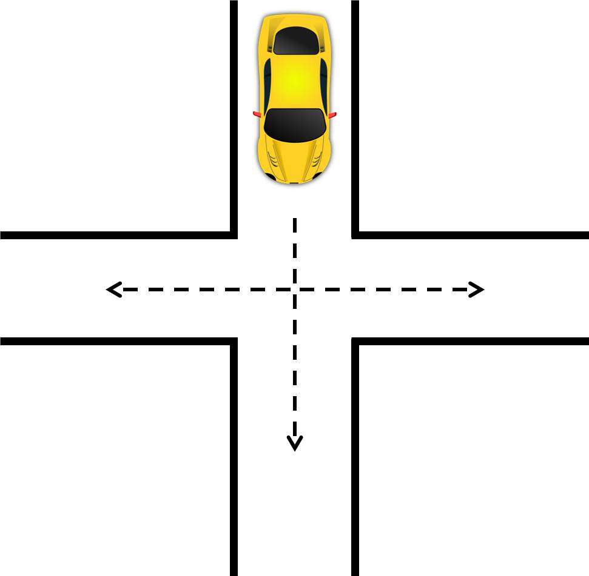
Multi-Way Selection Real Life Example #1

Slide 12

Multi-Way Selection Real Life Example #2

Slide 13
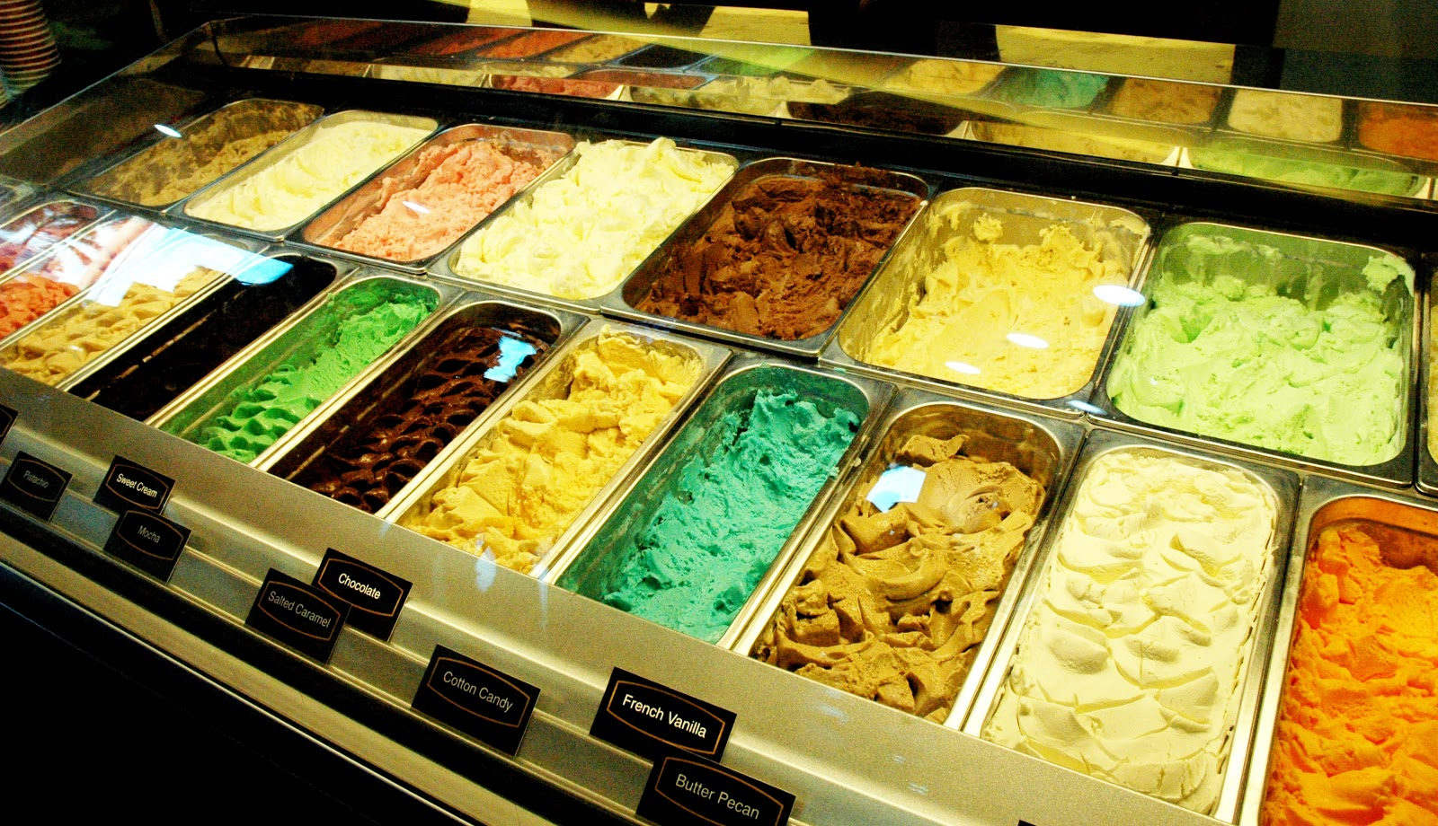
Multi-Way Selection Real Life Example #3

Slide 14
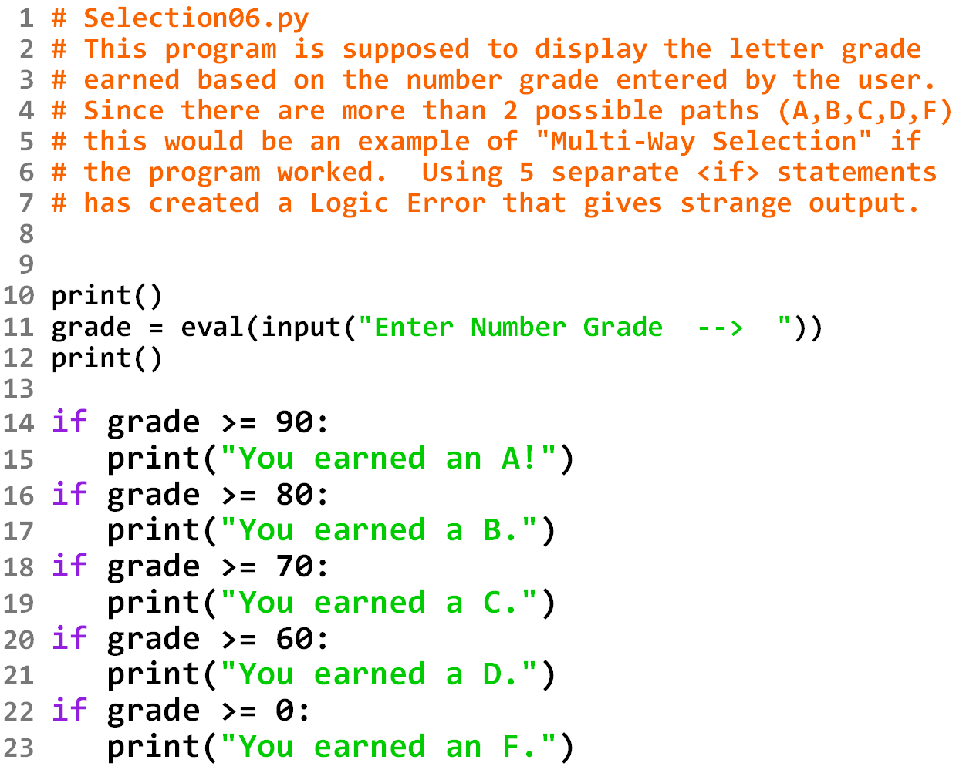

Slide 15
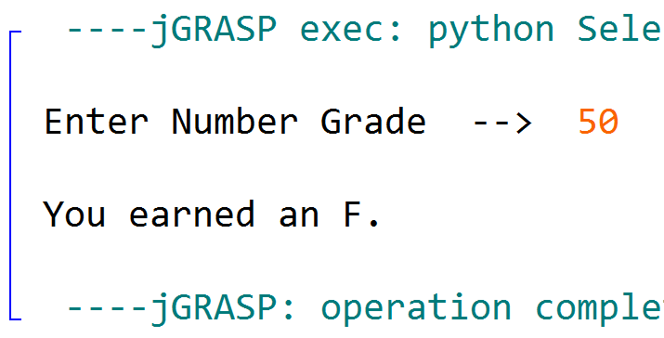

Slide 16
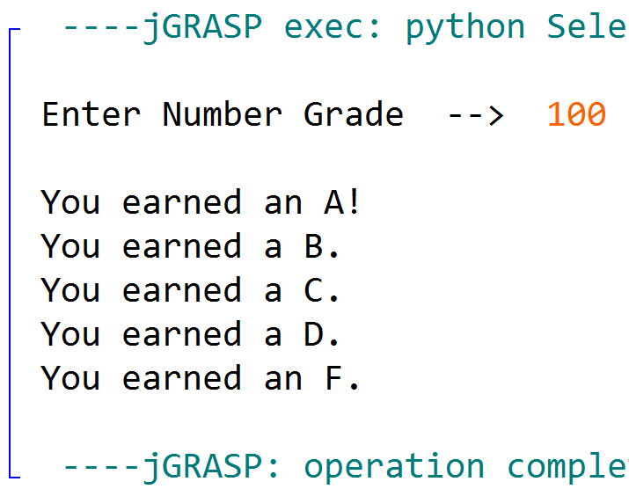

Slide 17
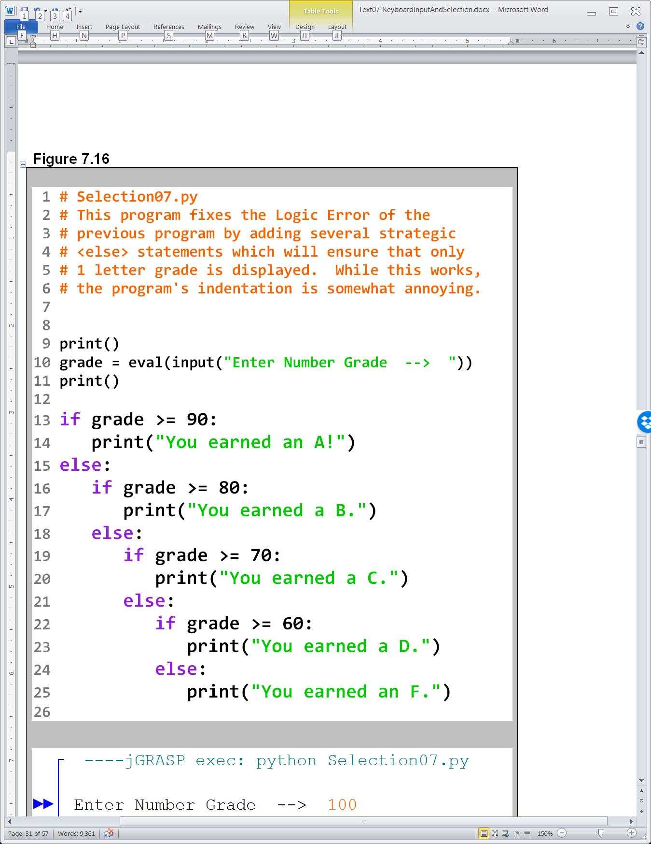

Slide 18
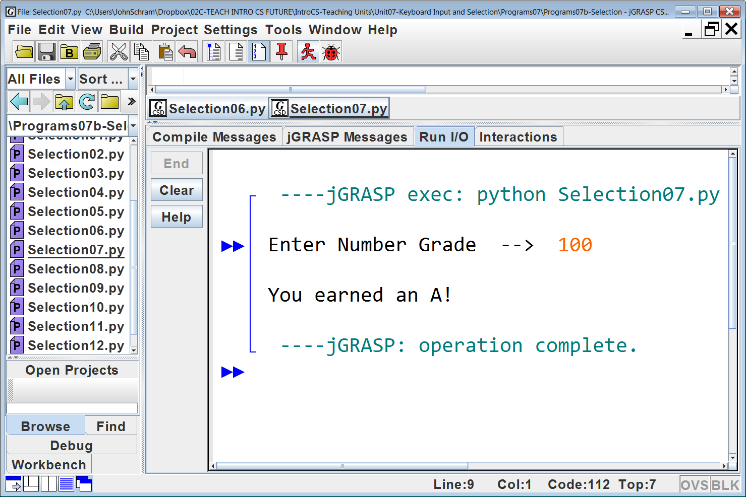


Slide 19
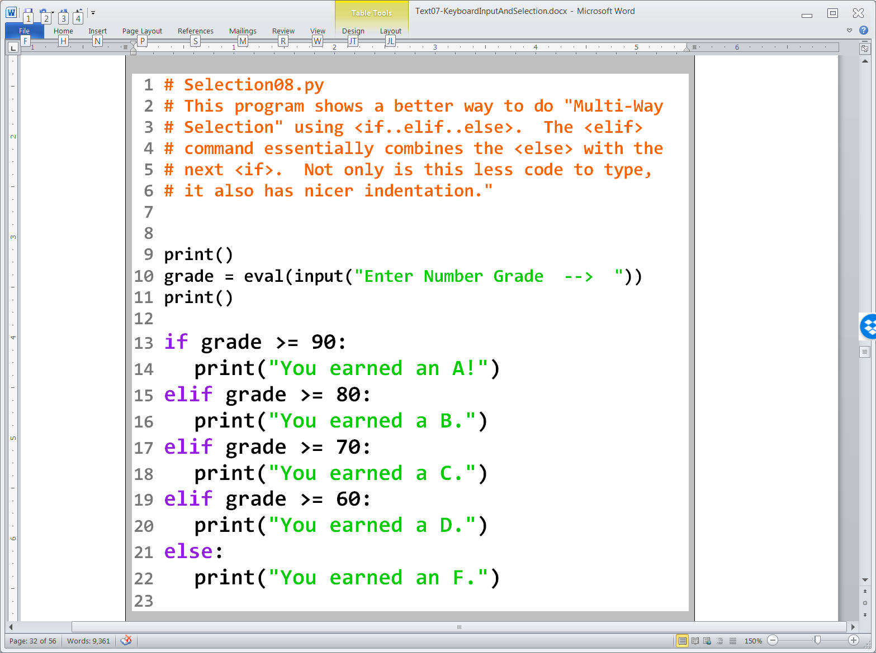

Slide 20
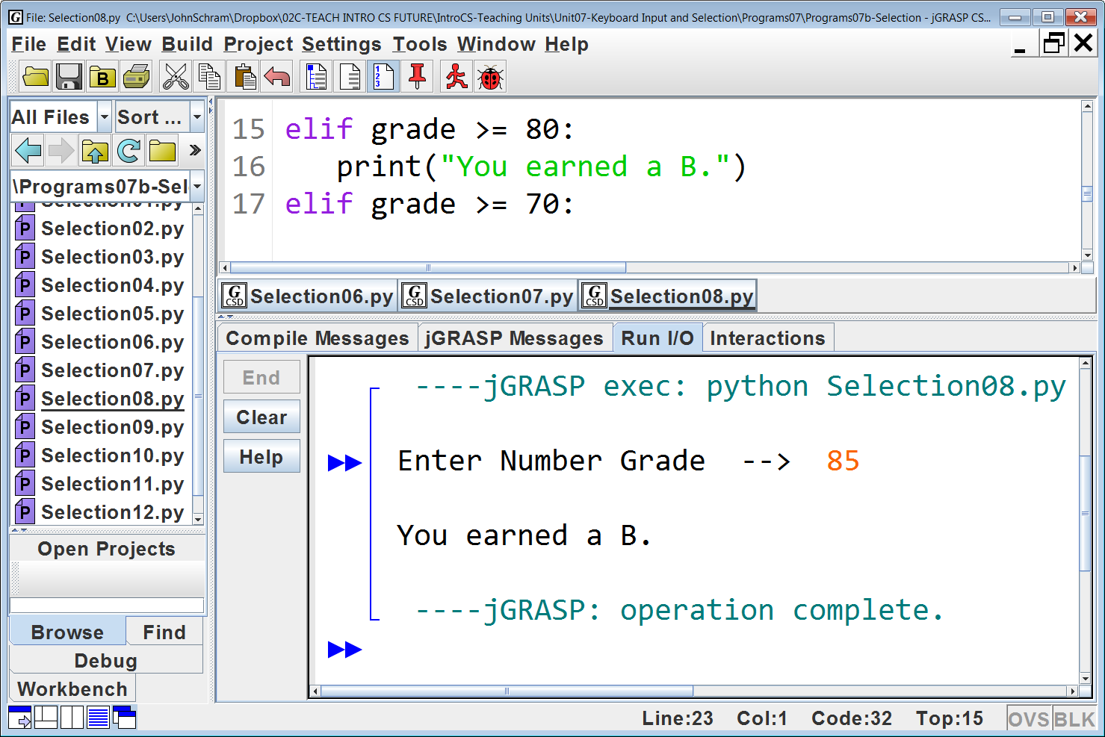
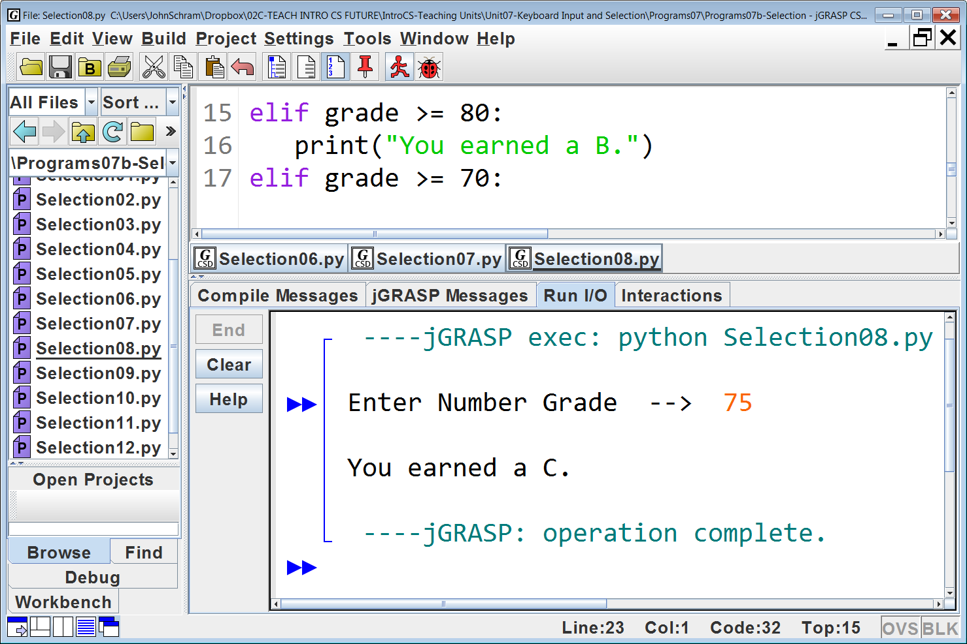

Slide 21
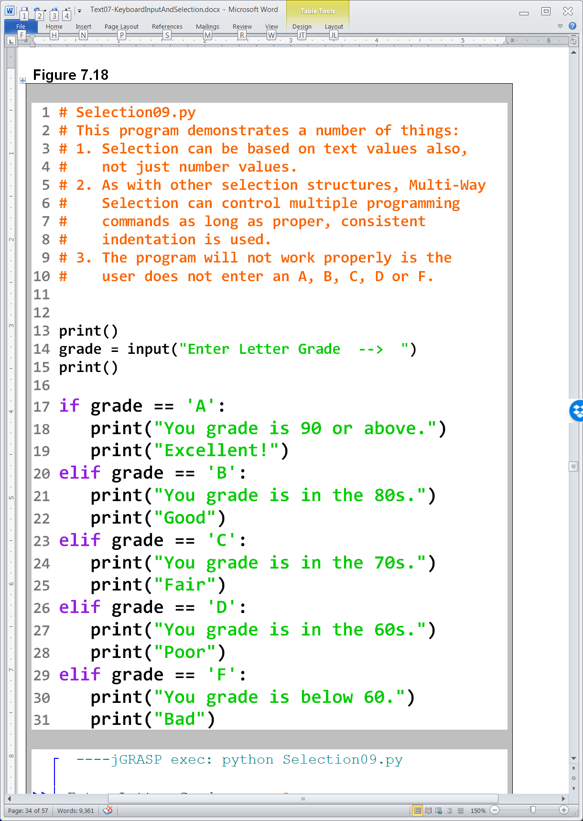
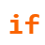

Slide 22
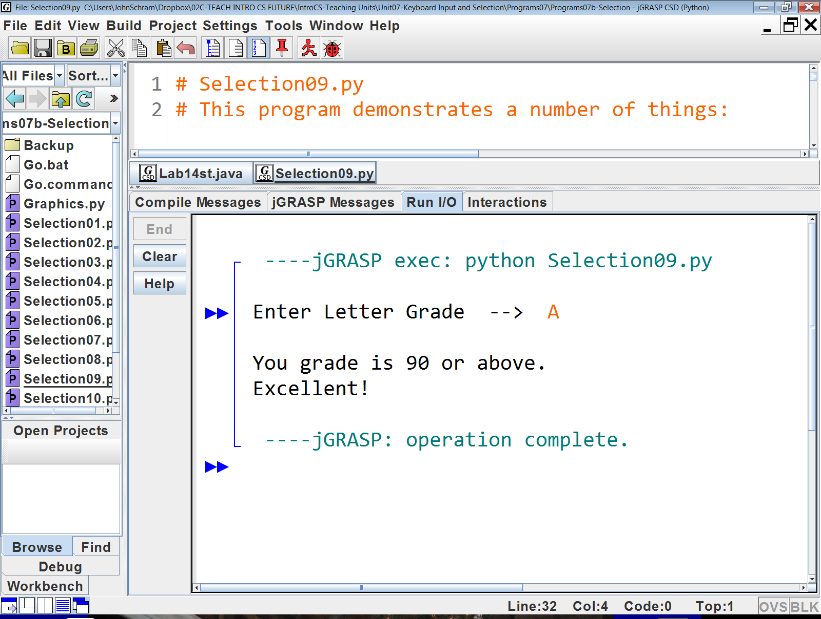

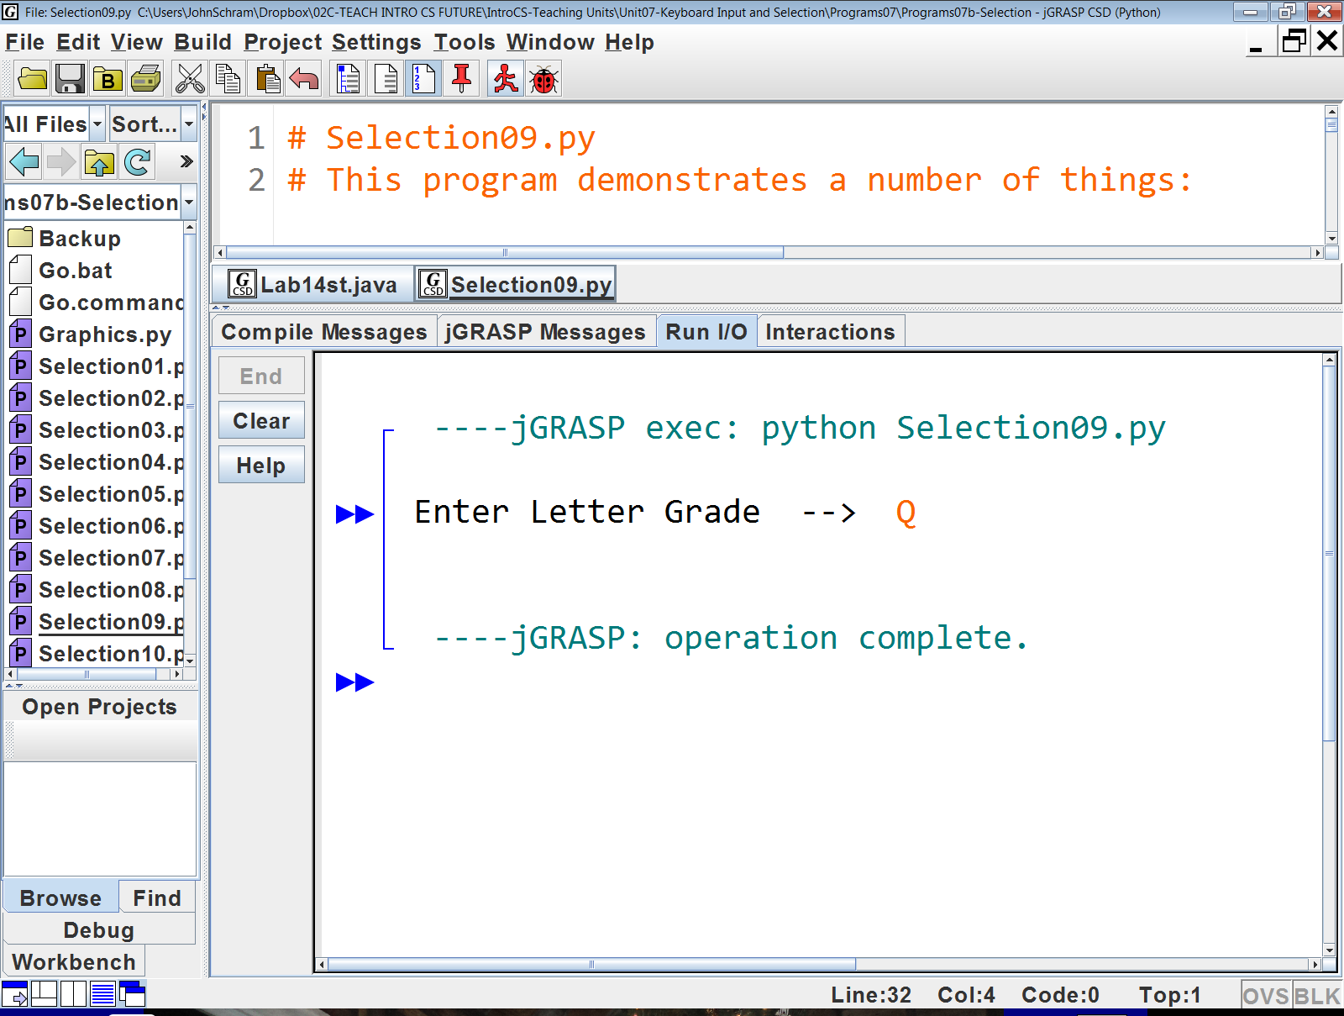

Slide 23
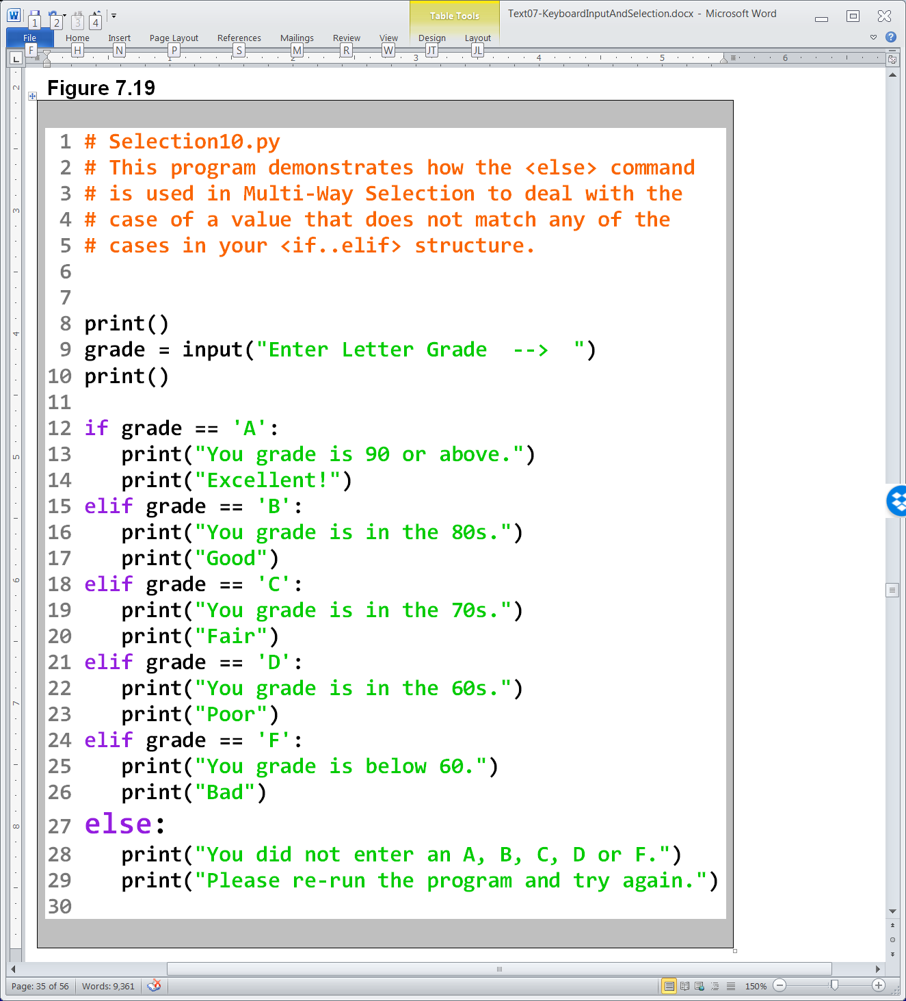

Slide 24
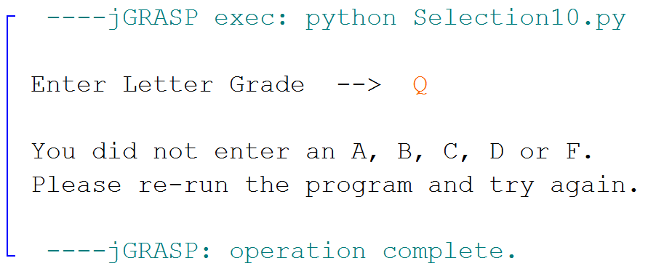

Slide 25
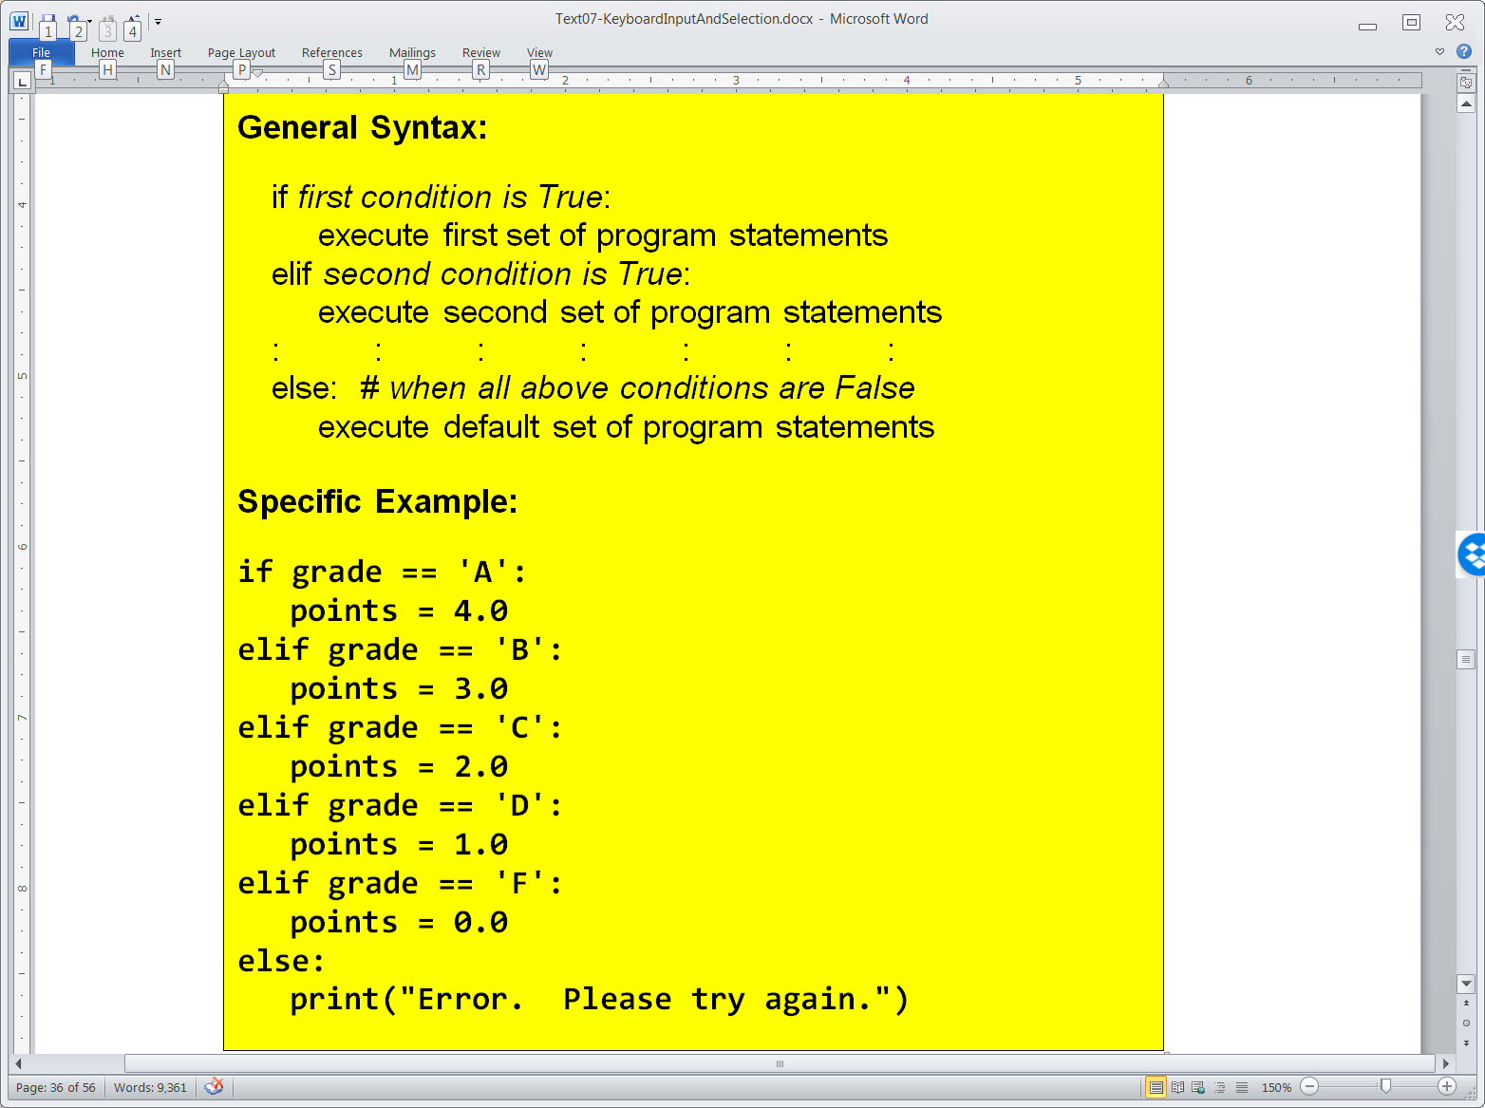
Multi-Way Selection

Slide 26

Section 7.8
Nested
Selection

Slide 27
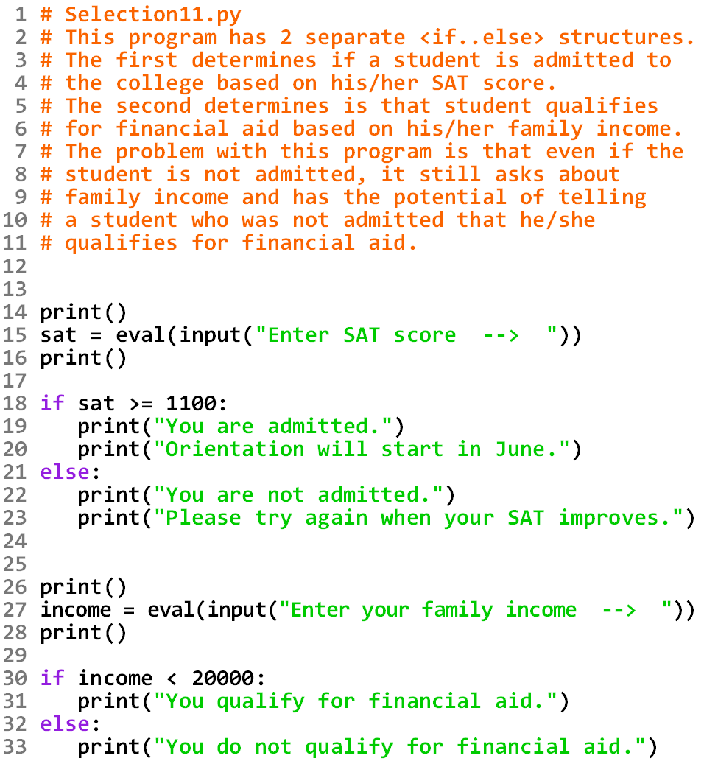

Slide 28
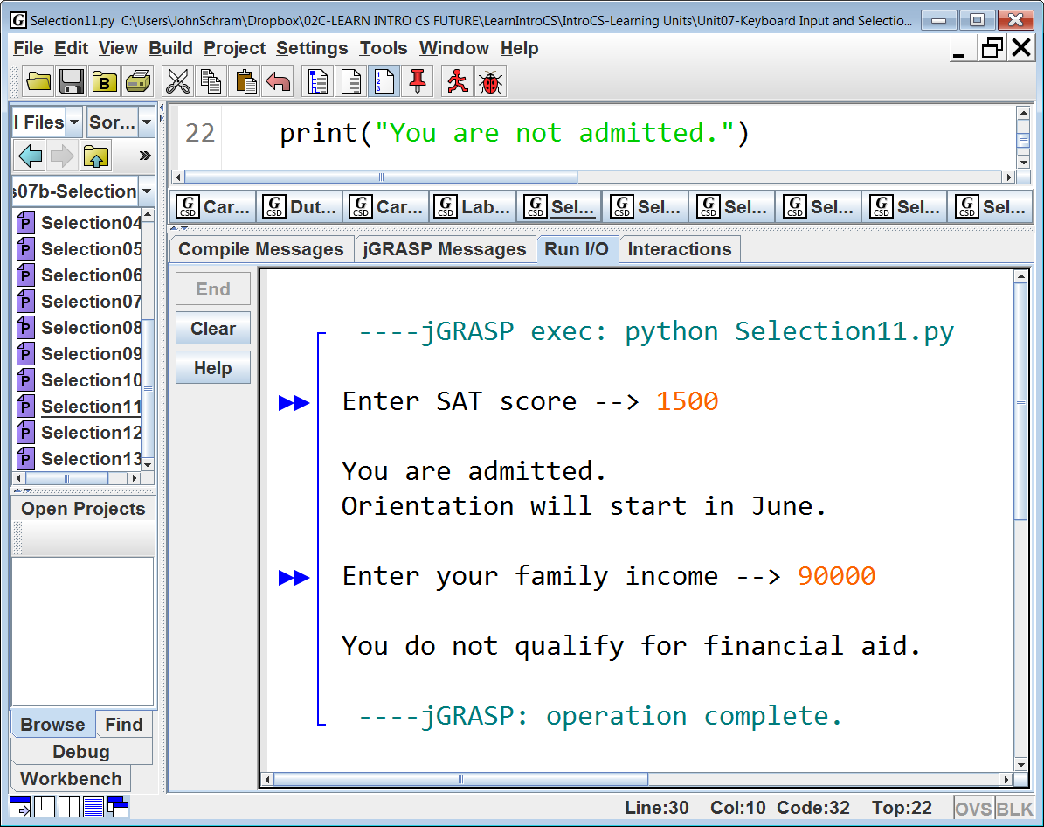
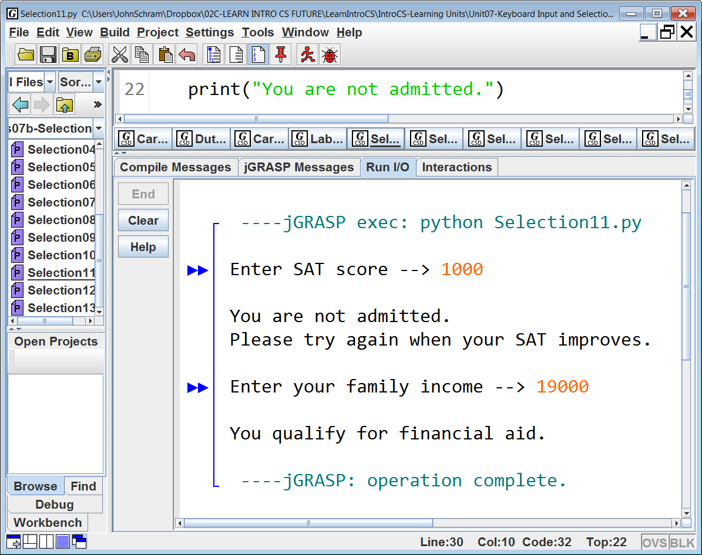

Slide 29
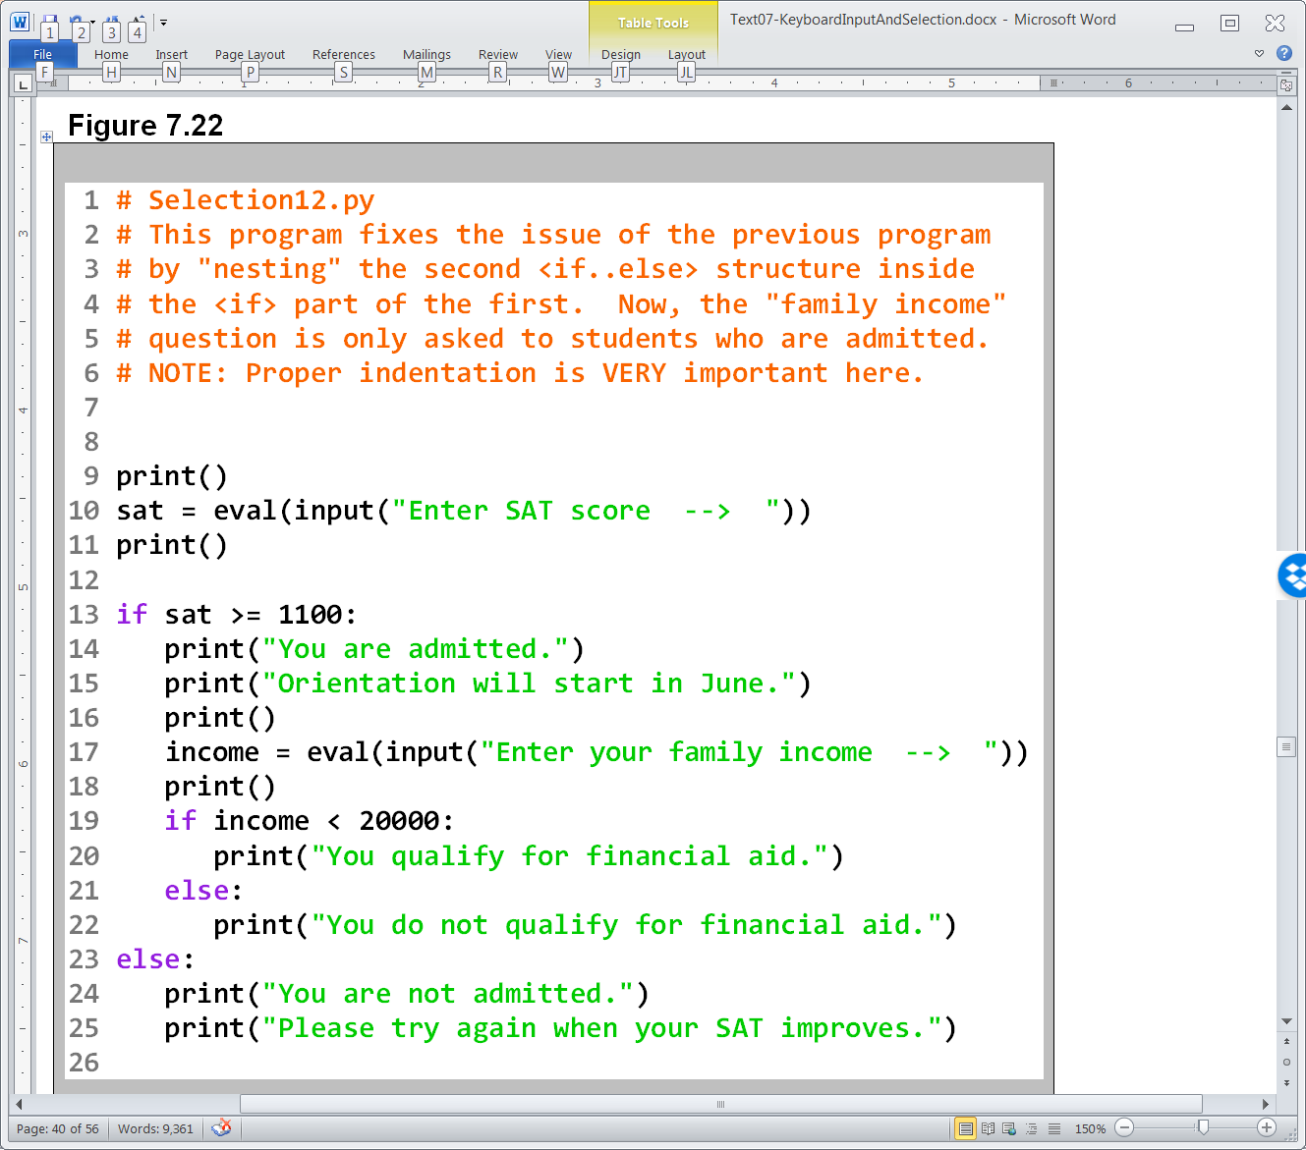

Slide 30
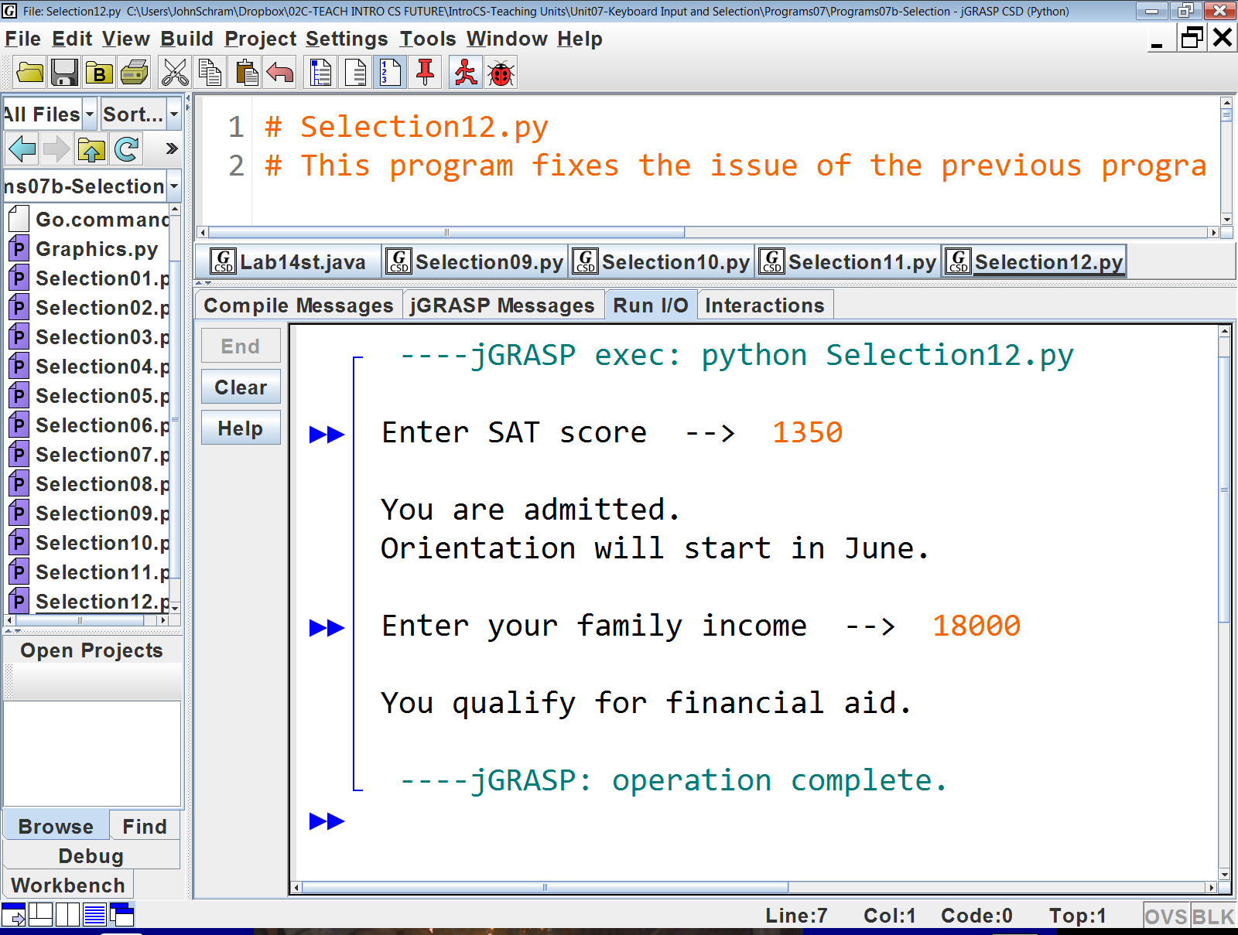
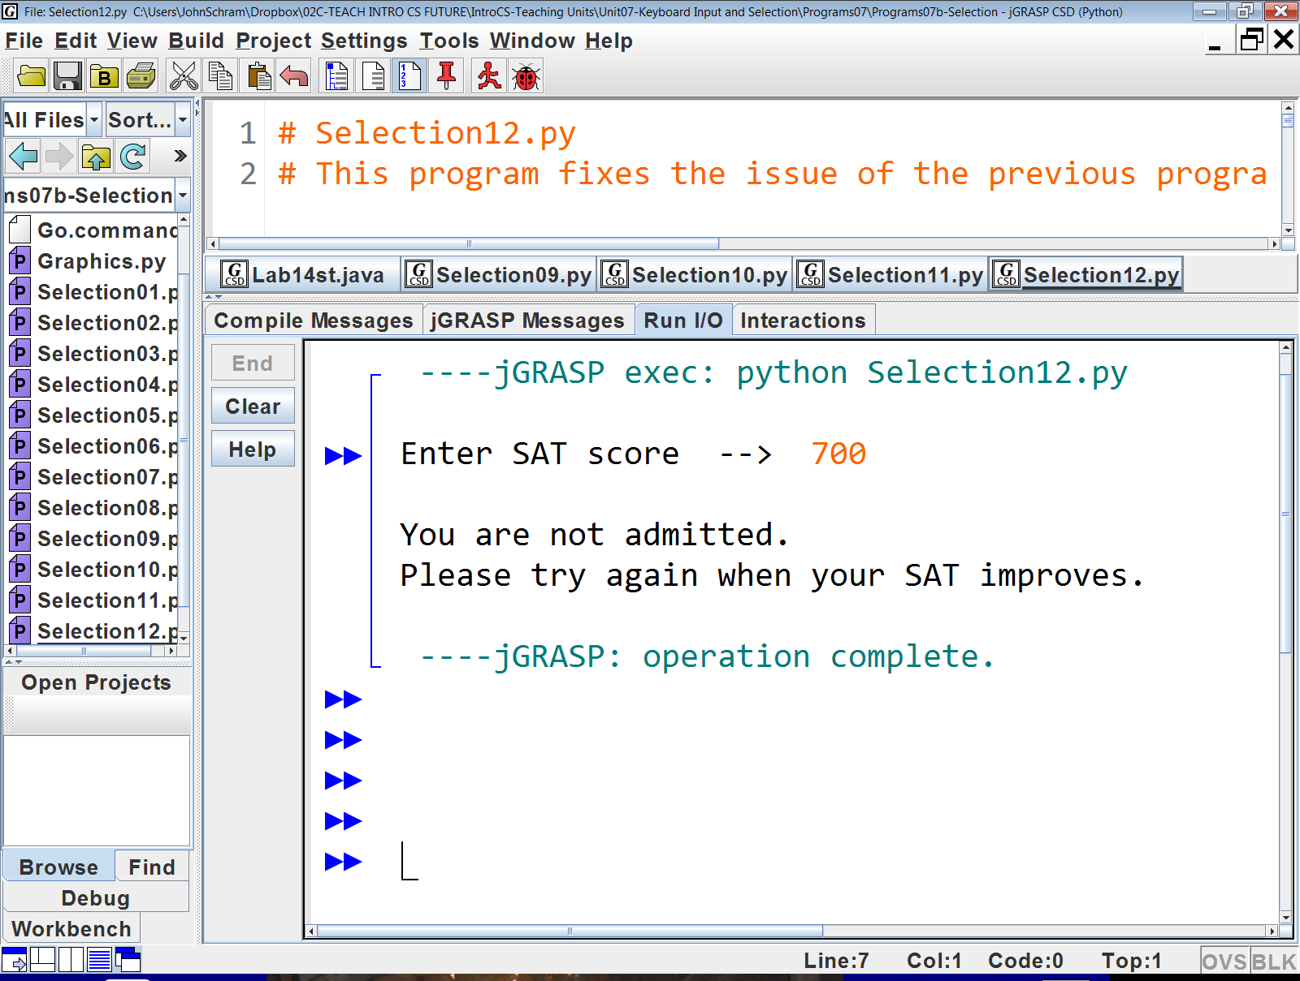
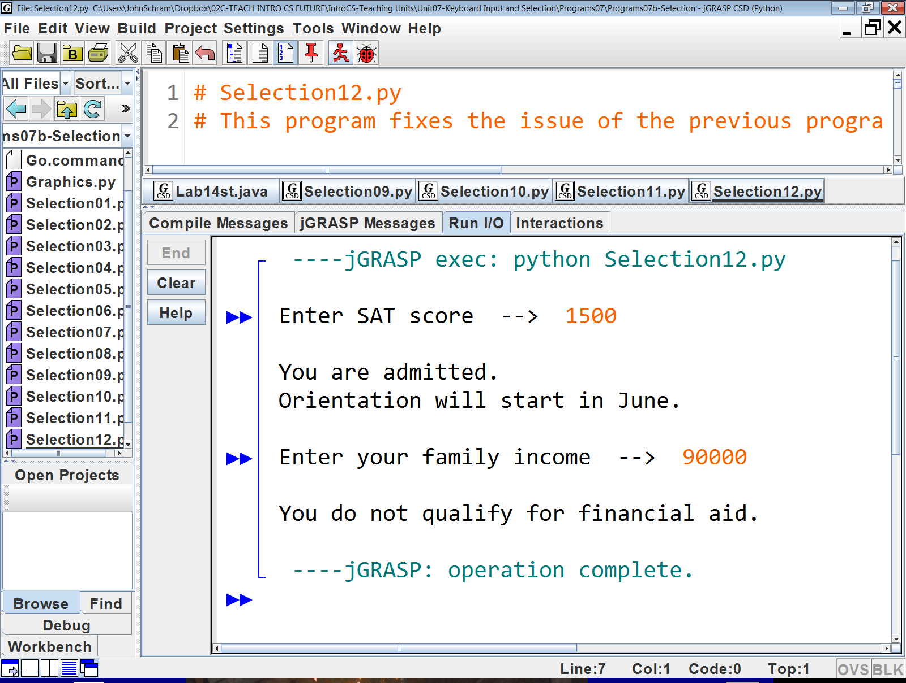

Slide 31
Section 7.9
Combining
Selection
with Graphics

Slide 32
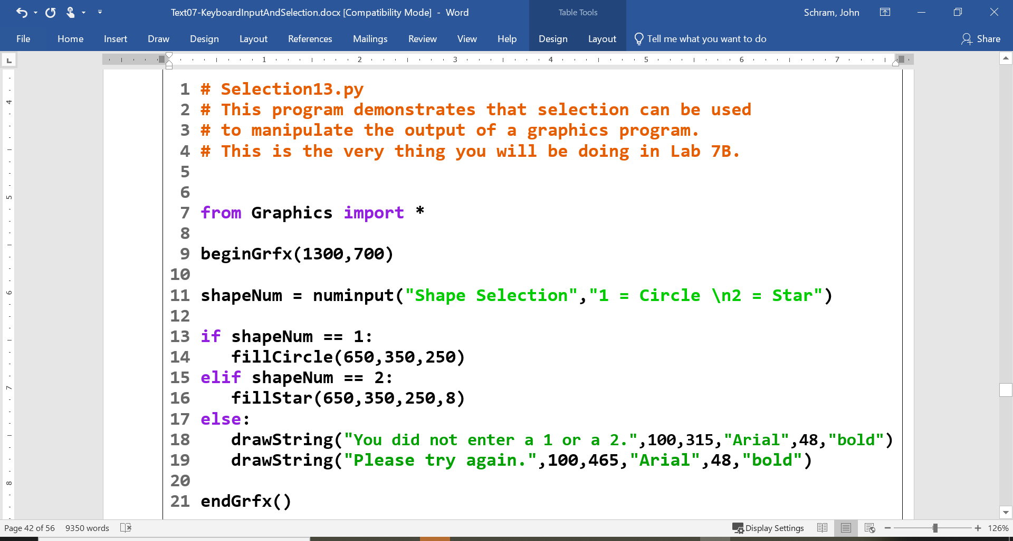

Slide 33
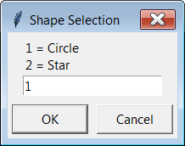
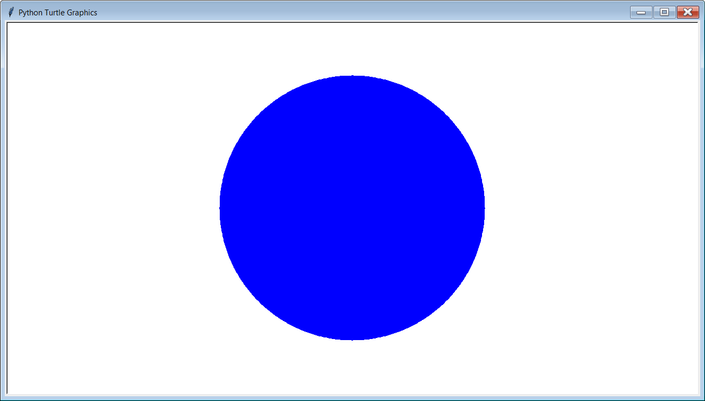
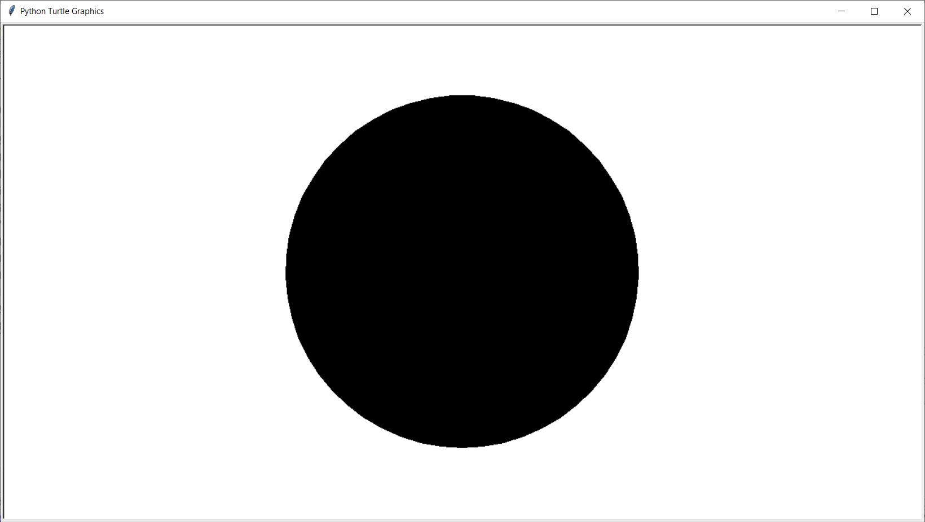

Slide 34
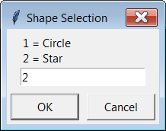
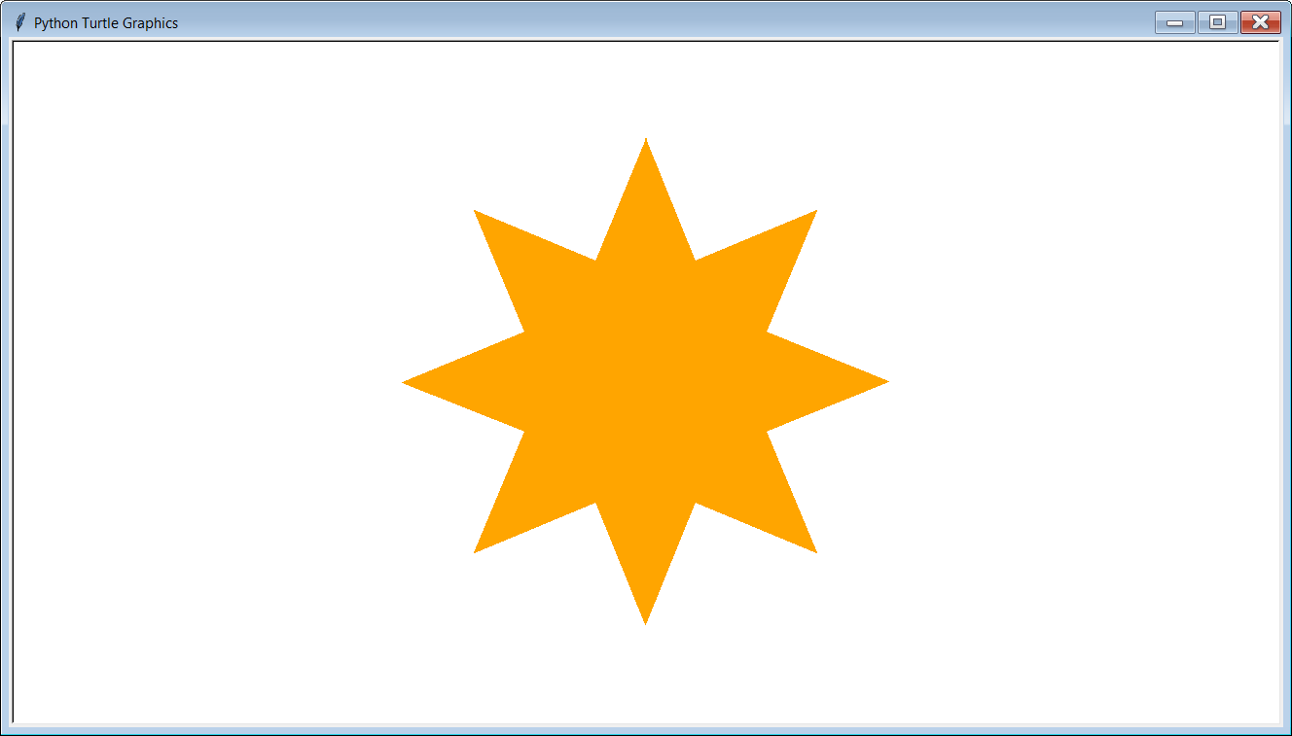
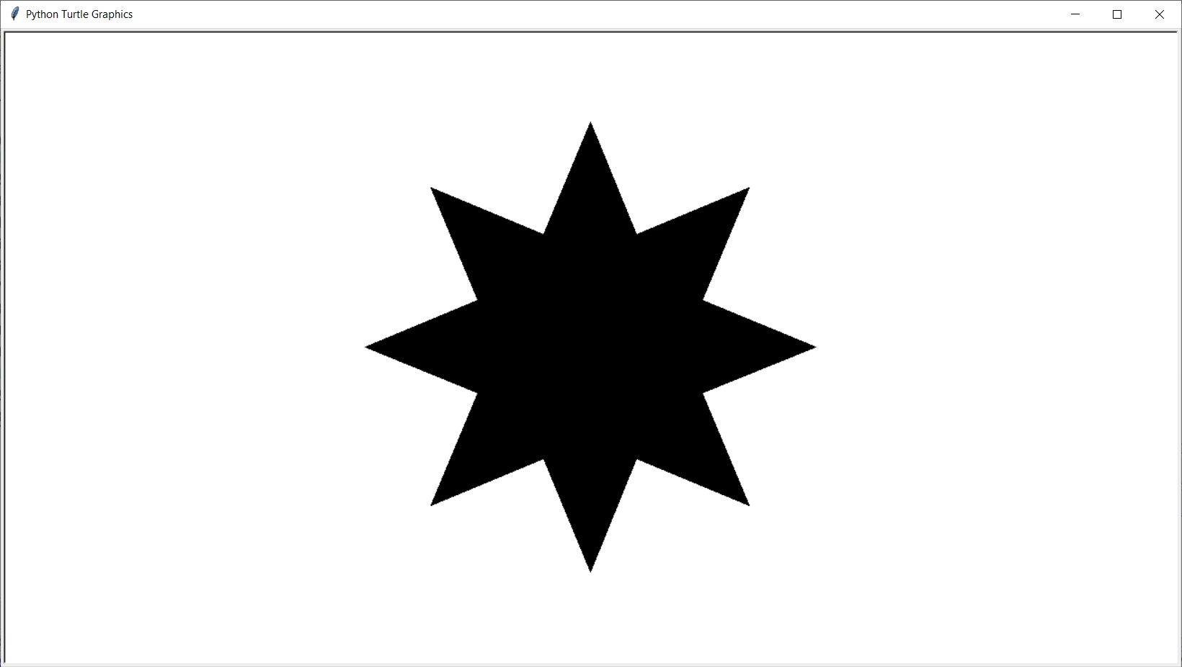

Slide 35

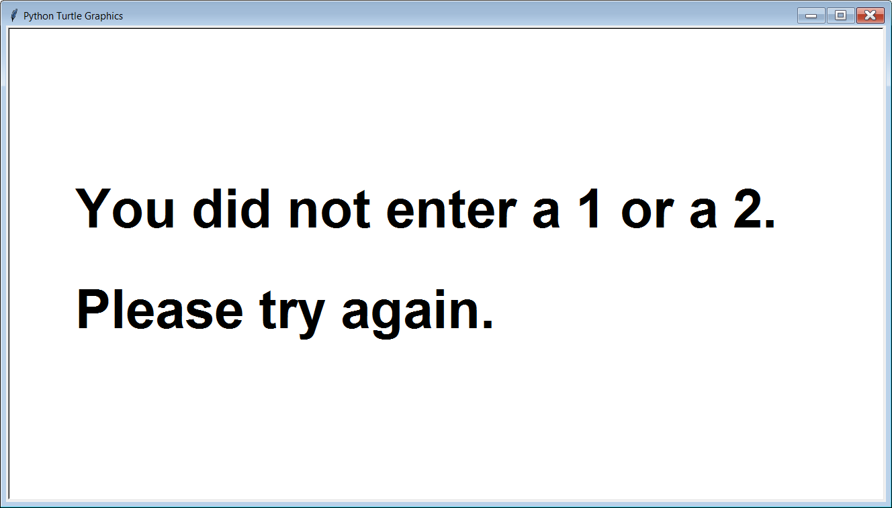

Slide 36
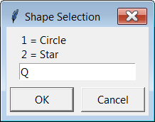
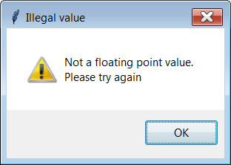

Slide 37
Section 7.10
Formatting
Numerical Output

Slide 38
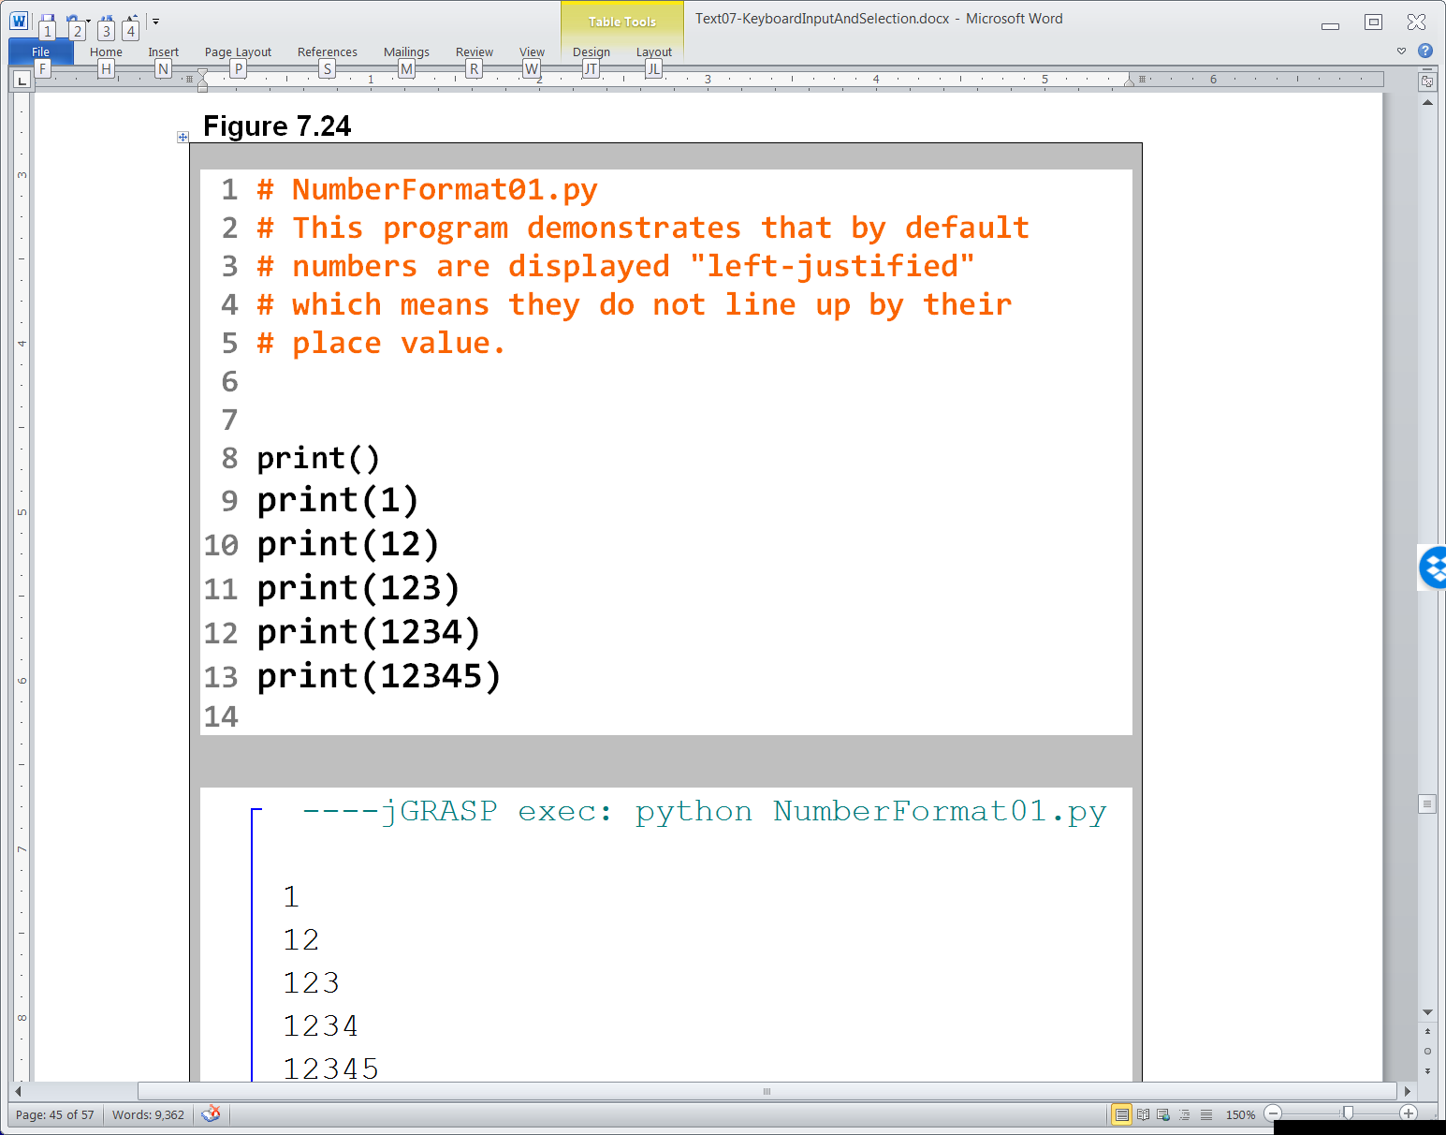
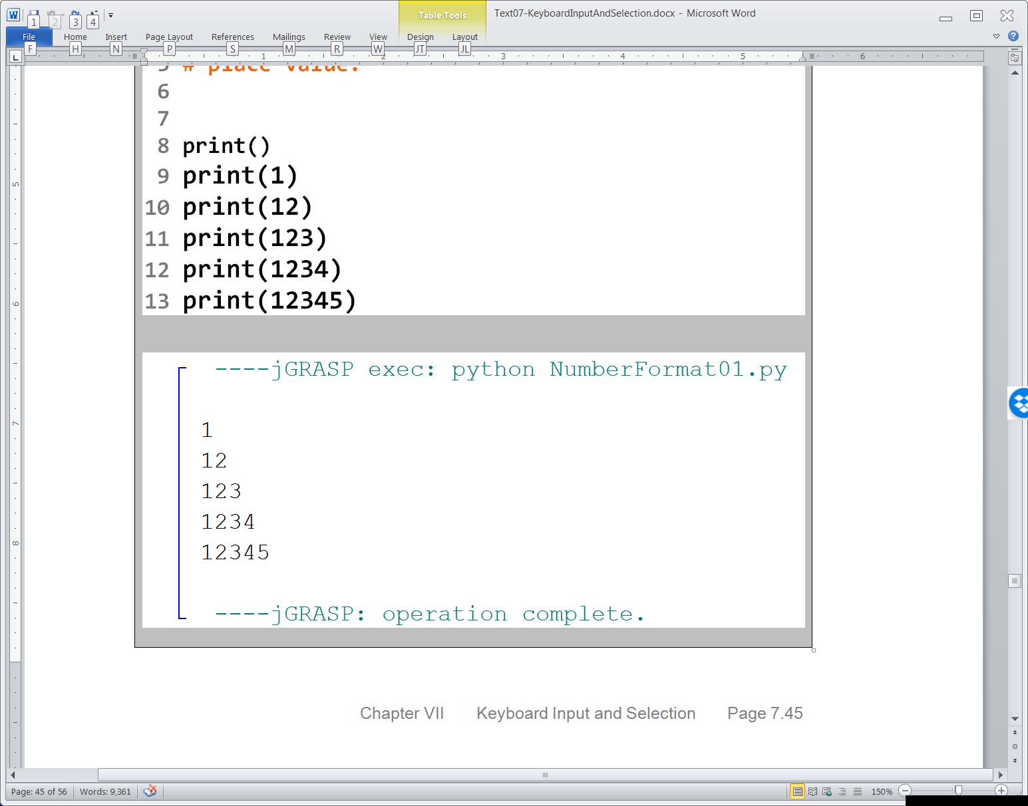

Slide 39
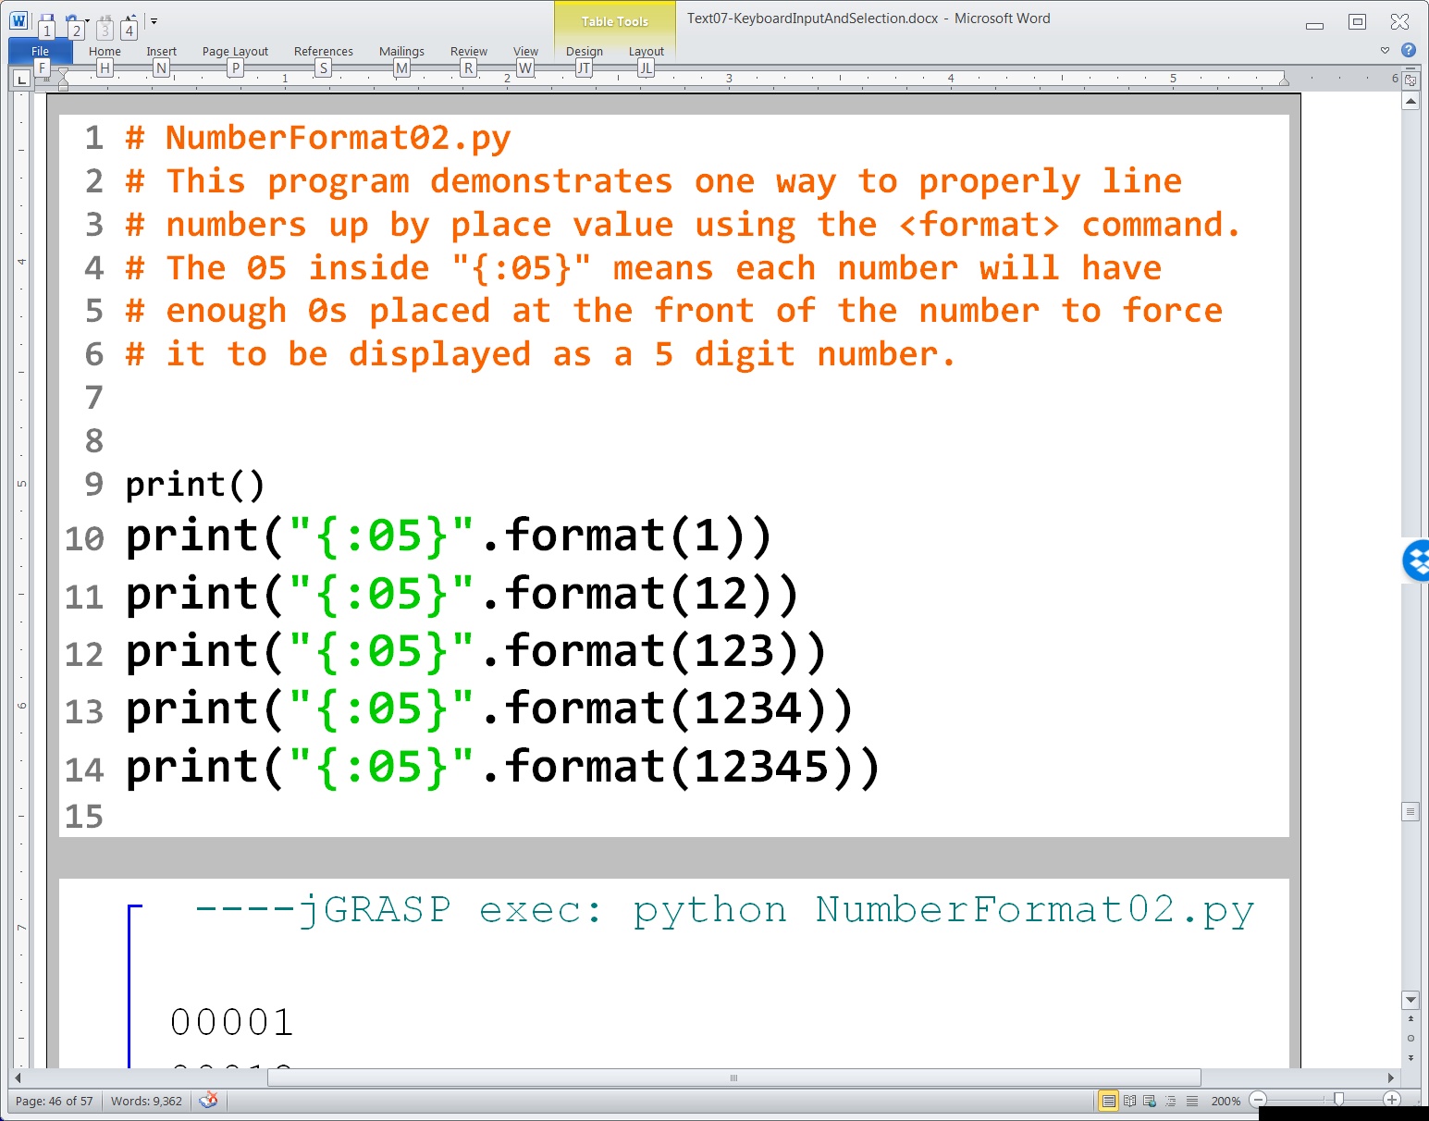
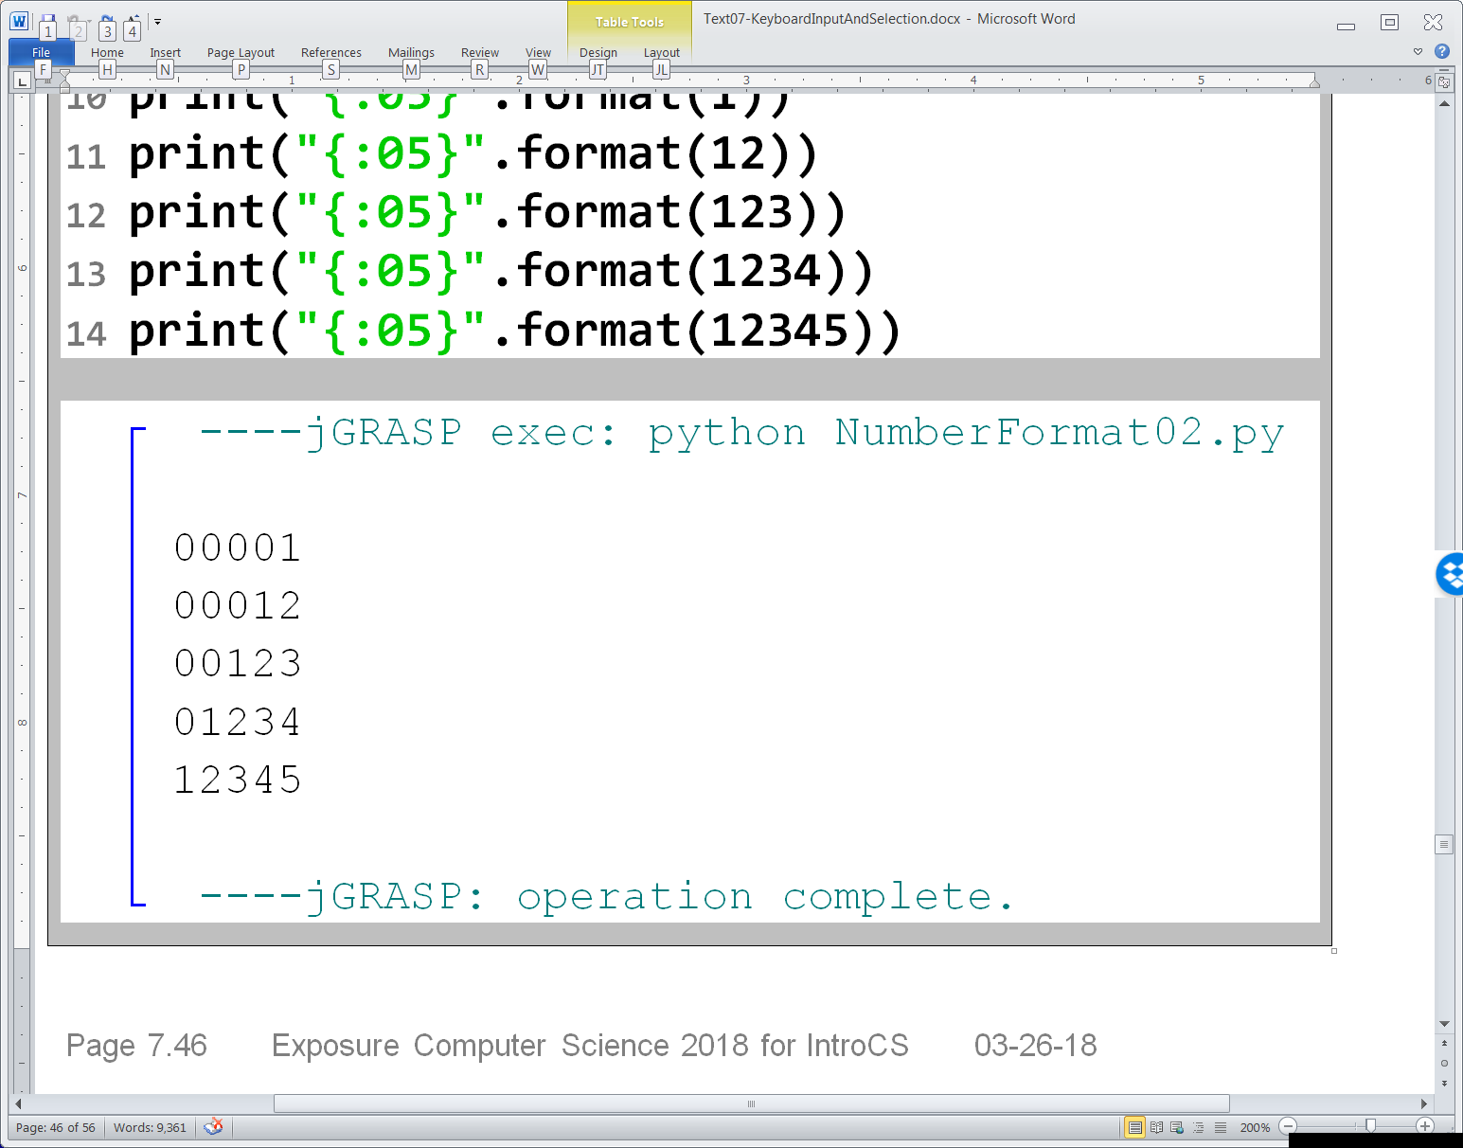

Slide 40
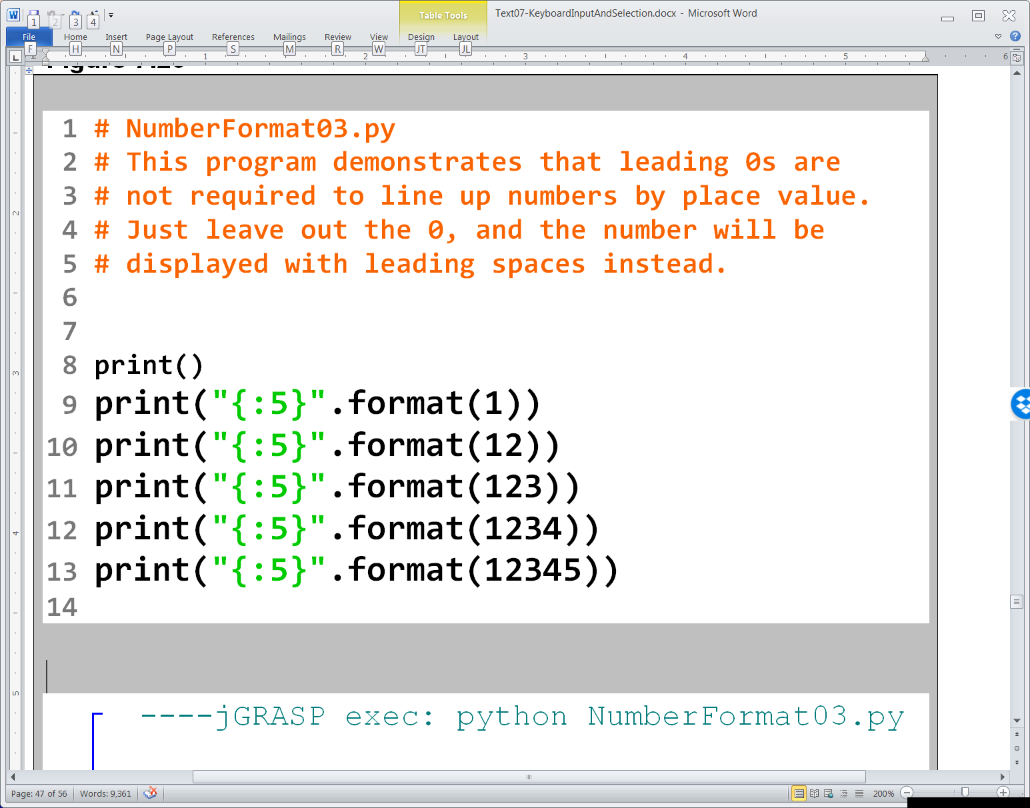
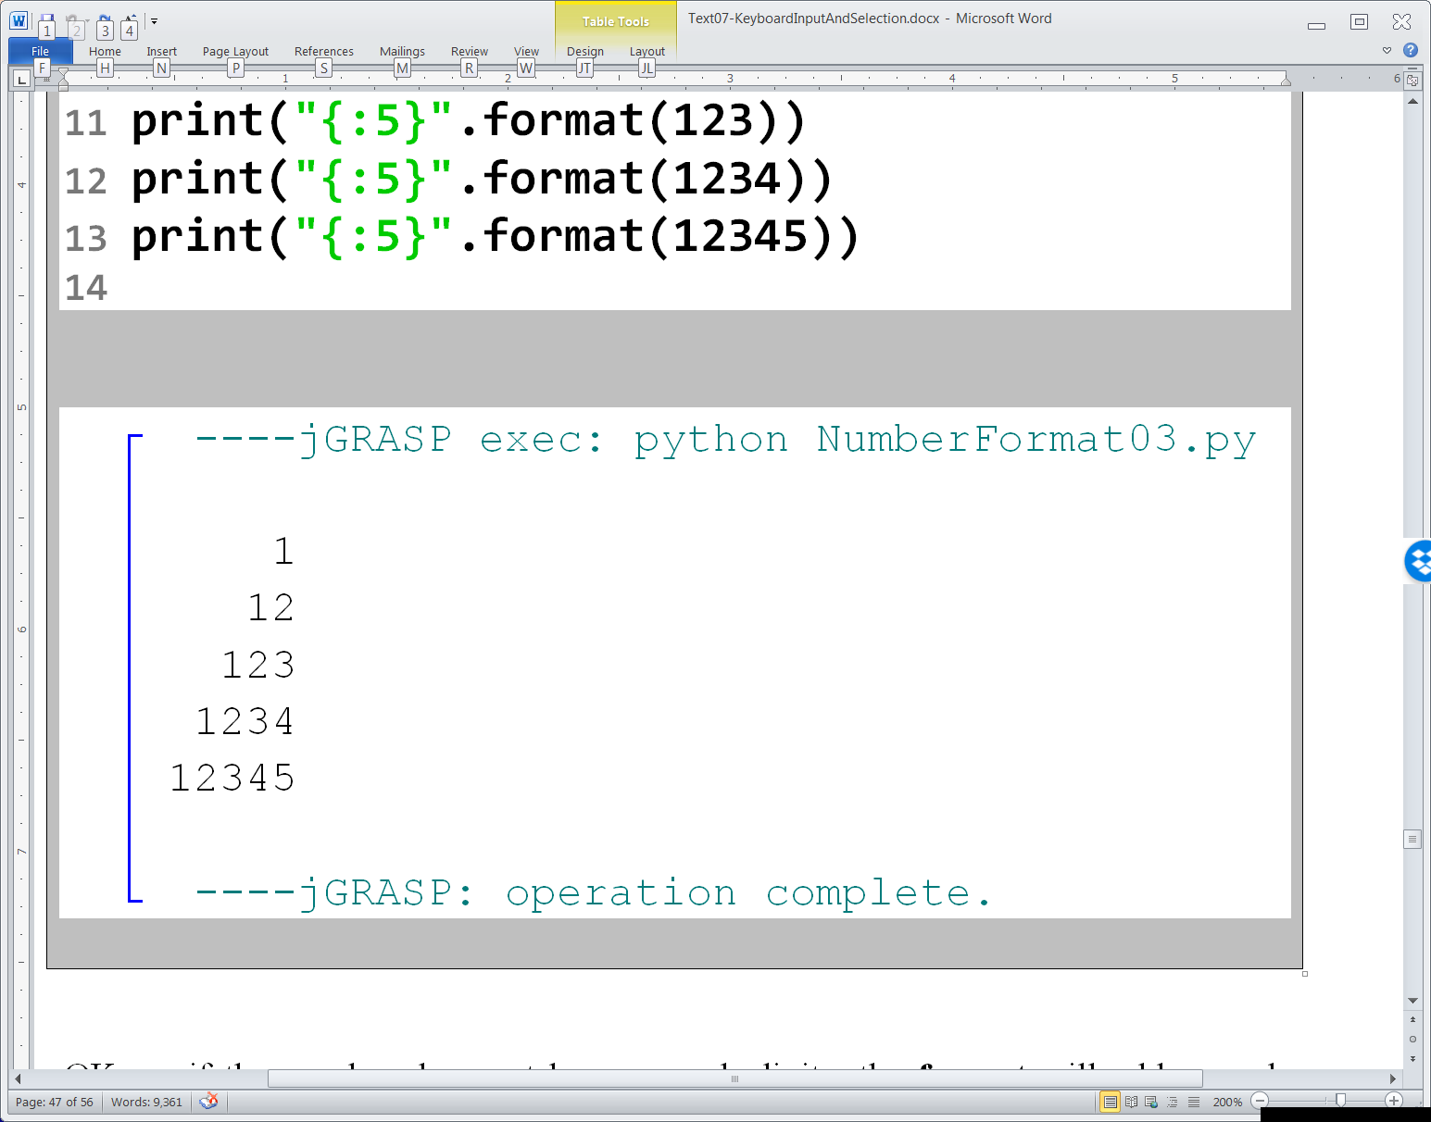

Slide 41
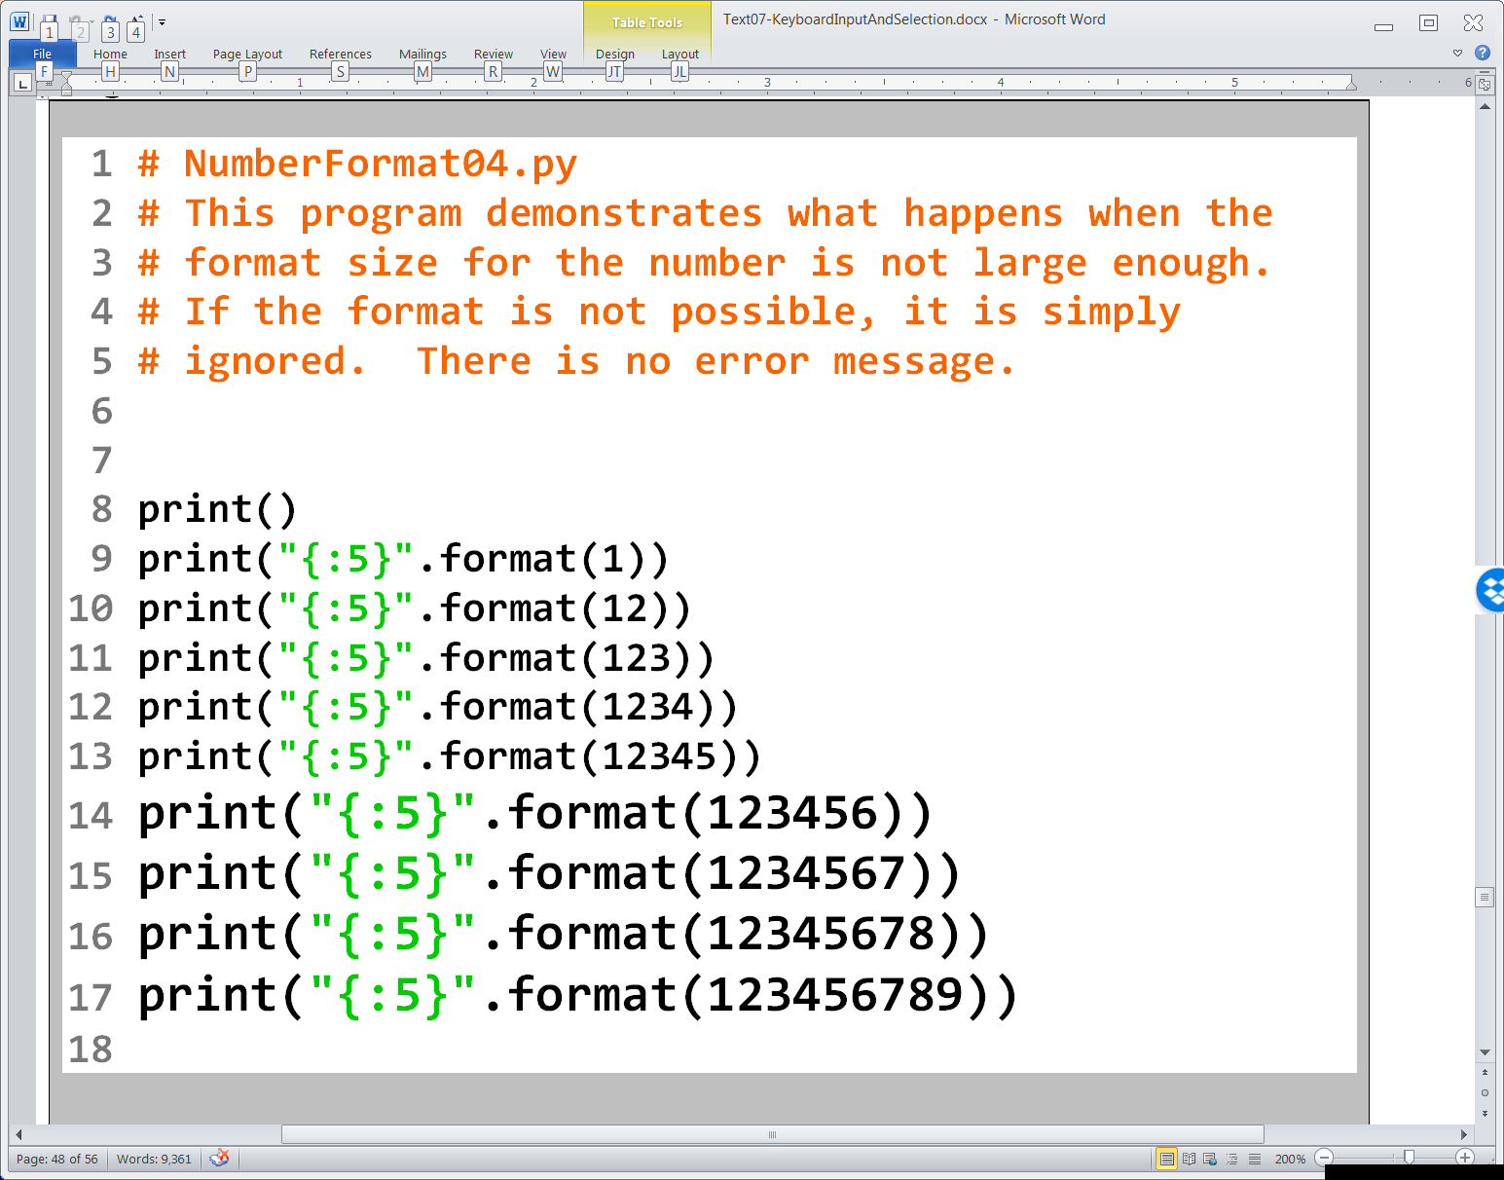

Slide 42
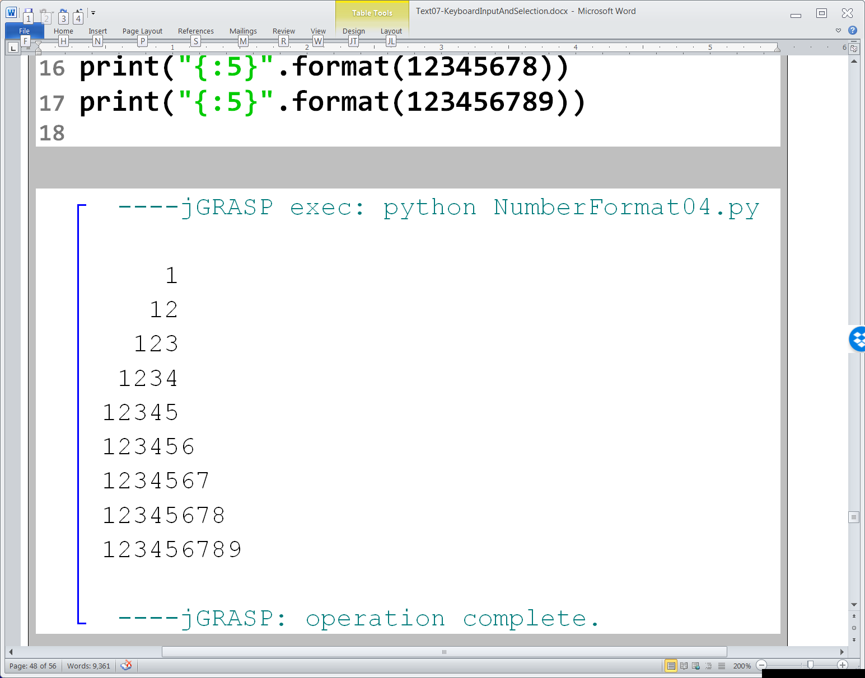

Slide 43

format Command Reality

Slide 44


Slide 45


Slide 46

The problem with program NumberFormat05.py
The number in format’s string literal does not specify the total number of digits, it specifies the total number of characters which includes digits, commas, and even the decimal point.

Slide 47



Slide 48



Slide 49


Slide 50


Slide 51


Slide 52


Slide 53


Slide 54


Slide 55


Slide 56


